Slide 2
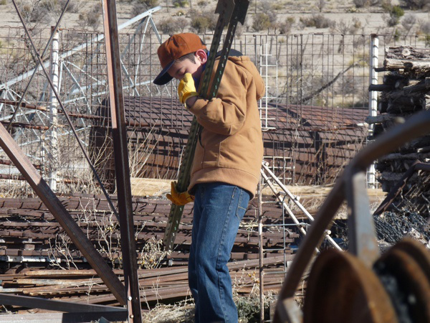
Where do you get the energy to...
play?
think?
work?
Notes:
Photo Credits
http://chess4kids.ch/en, http://the-back-40.com/2012/04/, and http://selfcosmos.com/wp-content/uploads/2014/07/o-POSITIVE-THINKING-facebook.jpg

Slide 3
Name some of your favorite foods…

Slide 4
All of those foods fit into one or more of the following categories:
Meat
Grains
Dairy
Vegetables
Fruits
Seeds

Slide 5
We eat many different kinds of food for our energy.
Where do you think this young
soybean plant gets its energy
to grow?
Notes:
Photo Credit: http://agriculturewire.com/us-genetically-modified-foods-confuse-consumers/

Slide 6
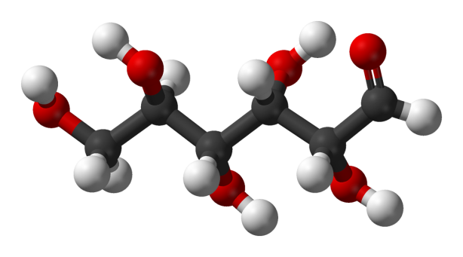
Plants get their energy from only one kind of food…
Glucose!

Slide 7
And, unlike us, plants make all of their own food.
Today you will learn how plants make glucose to supply their energy needs.

Slide 8
For this activity, your team will assemble 4 unique puzzles that tell the story of photosynthesis.
Puzzle 1 with the white border provides an overview of photosynthesis.
Puzzle 2 with the aqua border explains the photosynthesis chemical equation.
Puzzle 3 with the dark green border describes the structures within the leaf where photosynthesis occurs.
Puzzle 4 with the orange border shows the interdependence of plants and people.
Puzzle 5 with the red border graphs photosynthesis activity during one year.

Slide 9
Once your team has completed a puzzle, raise your hand, and you will be given an information sheet about that puzzle’s topic. After reading the information together as a team, you may move on to the next puzzle.
When you complete all four puzzles and readings, you may start on the worksheet.

Slide 10
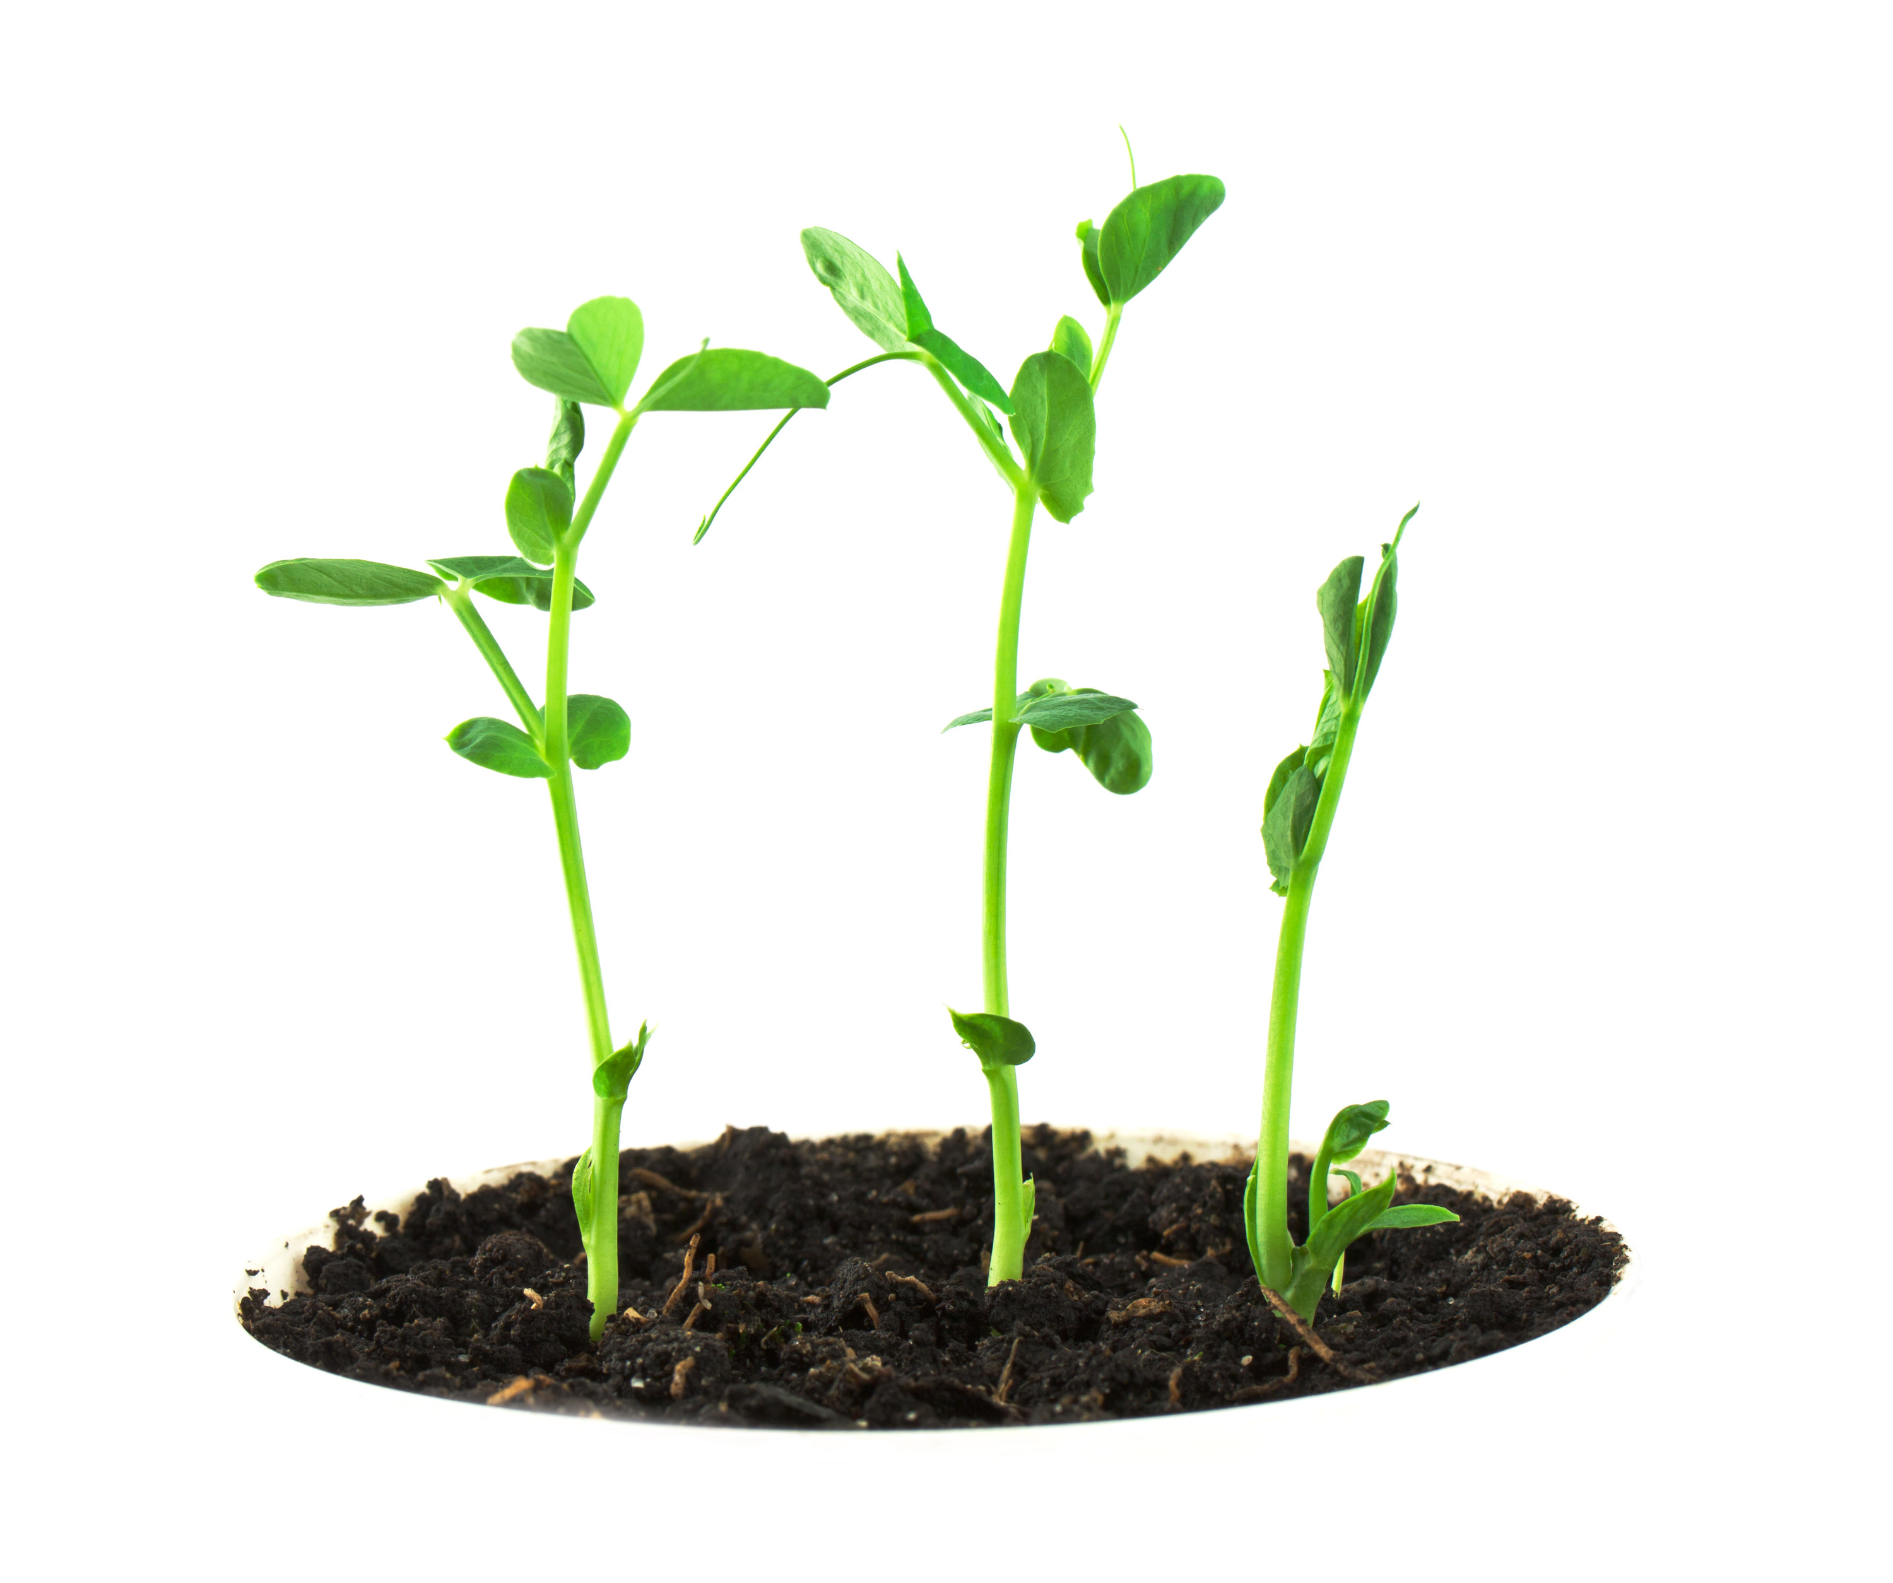
Plants grow because they produce their own food. We grow because we eat the plants--their roots, their stems, their leaves, and their seeds.
➔
Roots | Carrots and turnips
Stems | Celery and asparagus
Leaves | Spinach and lettuce
Seeds | Soybeans, corn, and wheat
➔
➔
➔

Slide 11
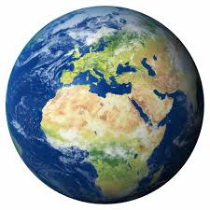
All life on Earth owes its existence to the process of photosynthesis.

Slide 12
The Simple Story of Photosynthesis and Food
Click image to play video.

Slide 13
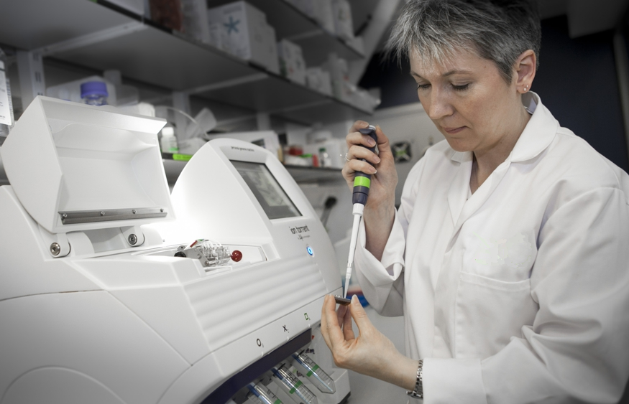
Scientists are identifying plant genes responsible for differing methods of photosynthesis. They hope that this research will lead to the development of plants that are more resistant to stresses such as drought and cold.
Notes:
Photo Credit: http://www.biorenewables.org/machine/ion-torrent-personal-genome-machine-pgm/

