Slide 1
What is Wellness?

Slide 2
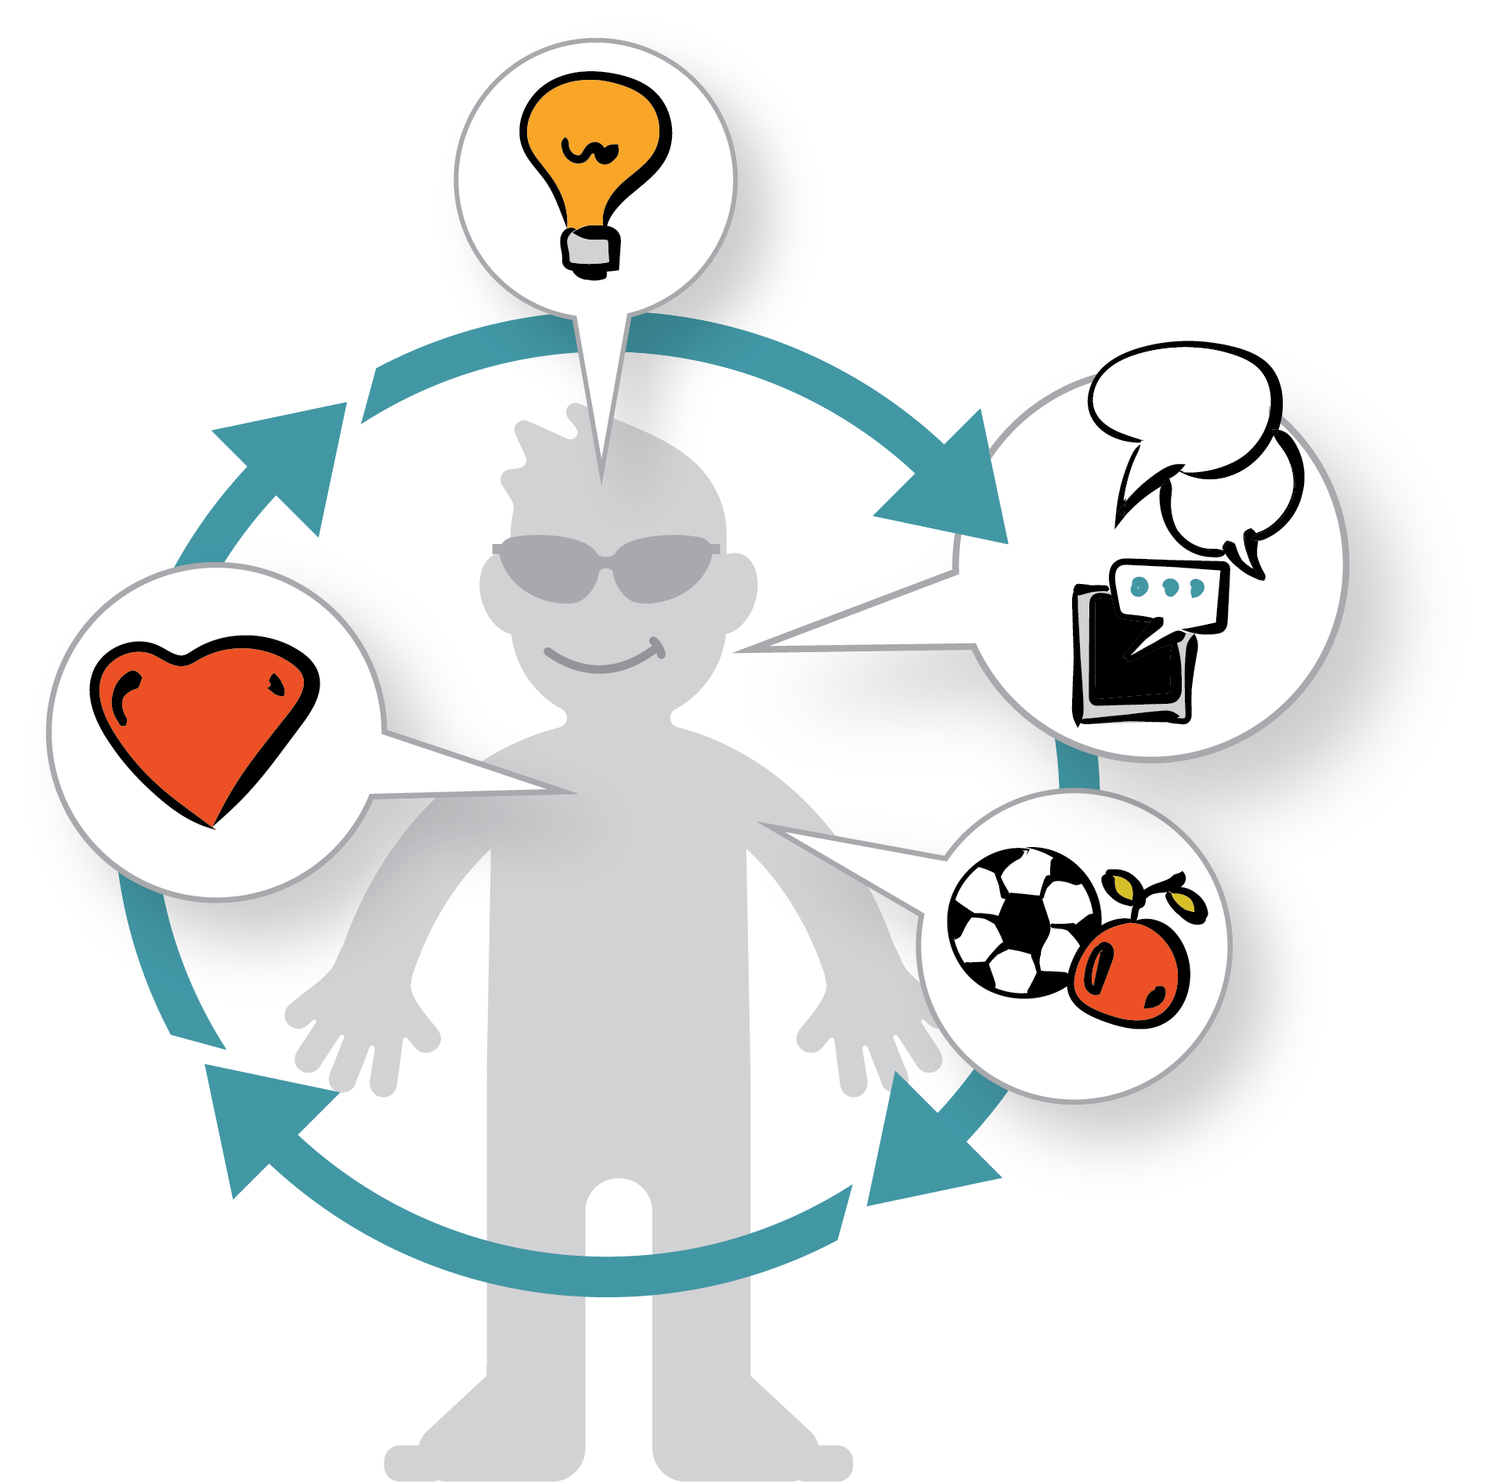
Wellness: Every Part Counts!
Wellness is about being healthy in heart, mind and body. It focuses on the whole person, not just one part.

Slide 3
Let’s break it down.
First, there’s the circle. That represents the whole person.

Slide 4
Let’s break it down.
Next we divide the circle into 3 equal parts.

Slide 5
Let’s break it down.
Now we label the parts:
Physical
Mental & Emotional
Social

Slide 6
Every part counts!
Here’s how the all parts form the whole.

Slide 7
Let’s break it down.
Physical Health having a healthy diet, active lifestyle
Social Health getting along well with others– in person & online
Mental & Emotional Health thinking clearly, coping with stress & feelings

Slide 8
Physical Health
Let’s start with Physical Health. That’s the one we all talk about the most.
How can we strengthen our physical health?
Getting exercise every day
Eating a nutritious diet
Getting enough sleep

Slide 9
Social Health
How can we strengthen our social health?
Being a good friend
Communicating our feelings
Cooperating with others
Having respect for people who are different than us
Showing kindness toward others
Standing up to bullies

Slide 10
Mental & Emotional Health
How can we strengthen our mental and emotional health?
Talking about our feelings and learning how to manage them
Learning skills to cope with stress and challenges
Reaching out for help from a trusted adult when we need it
Being physically active, eating a balanced diet, and getting enough sleep
Doing activities we enjoy with other people

Slide 11
Activity: Make a Wheel of Wellness

Slide 12
Activity: Make a Wheel of Wellness
Materials:
Paper
Compass
Yarn or string
Pencil
Paperclips
Push pins
Scissors

Slide 13
Draw a circle.
Take a piece of paper and draw a large circle on it with your pencil. Use up most of the space on the paper. You may use a compass, or for an extra challenge, try drawing one freehand, using one of the following techniques.
Why try it without a compass? Because it’s fun!

Slide 14
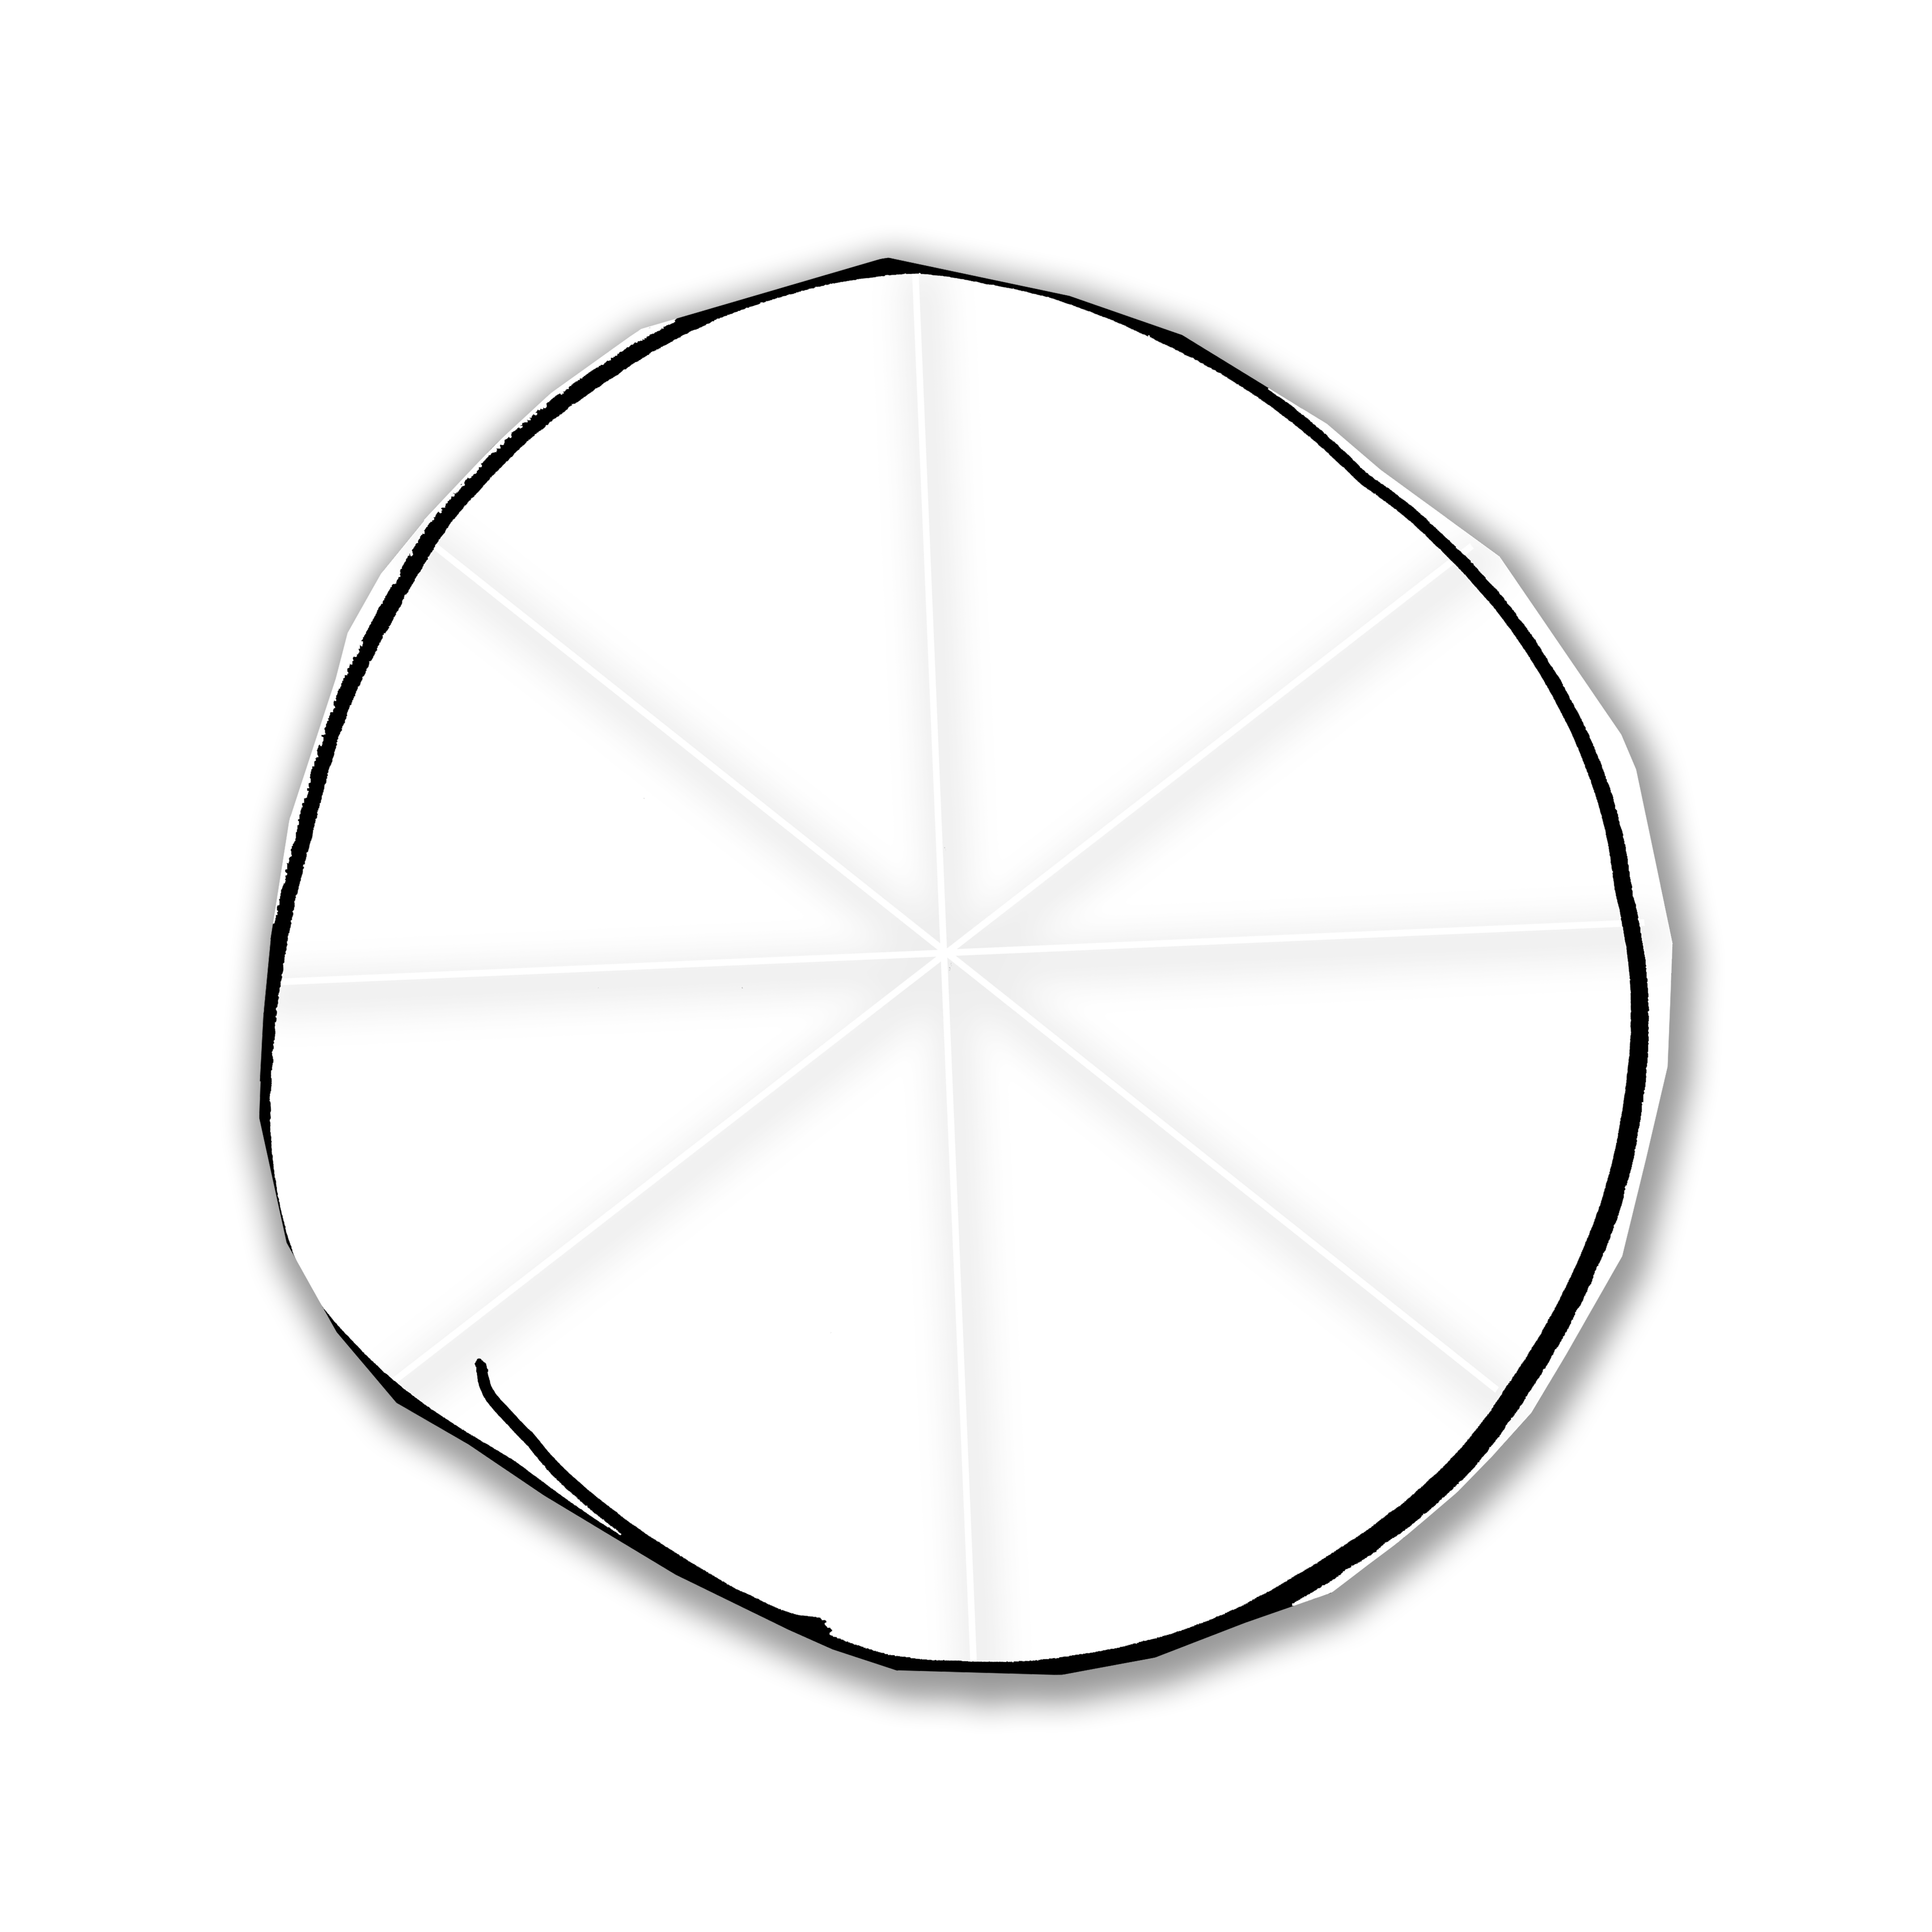
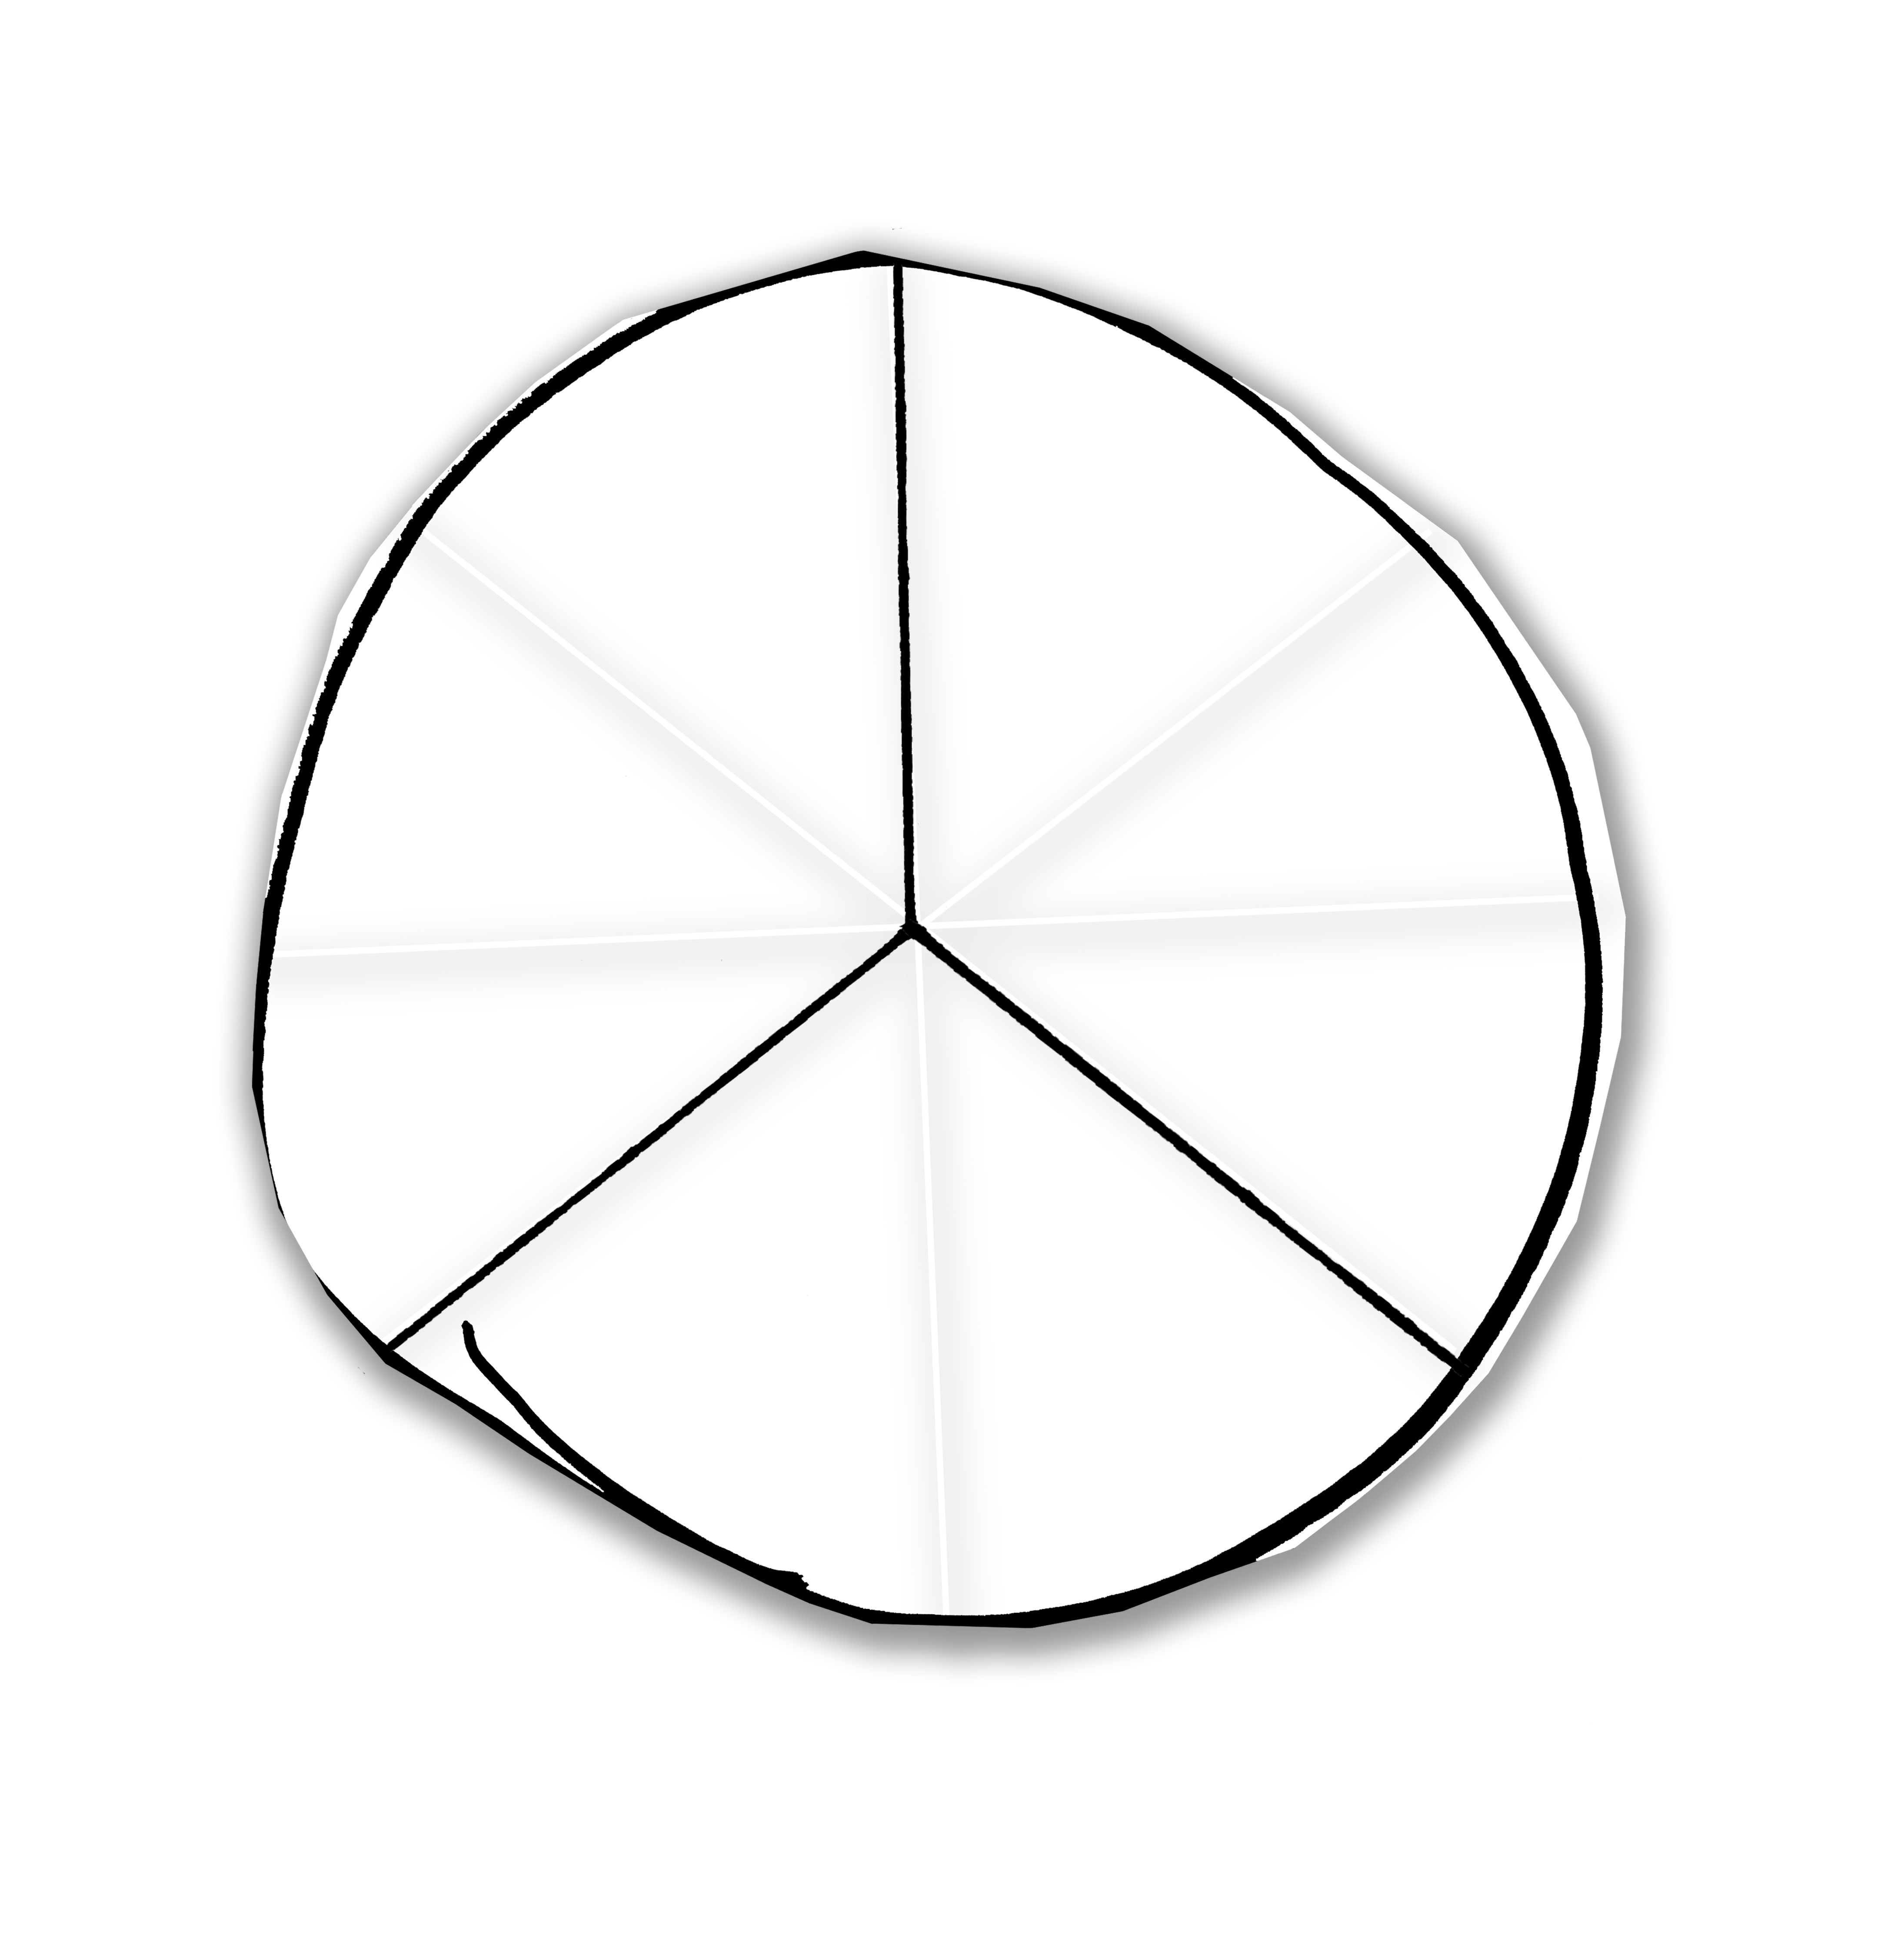
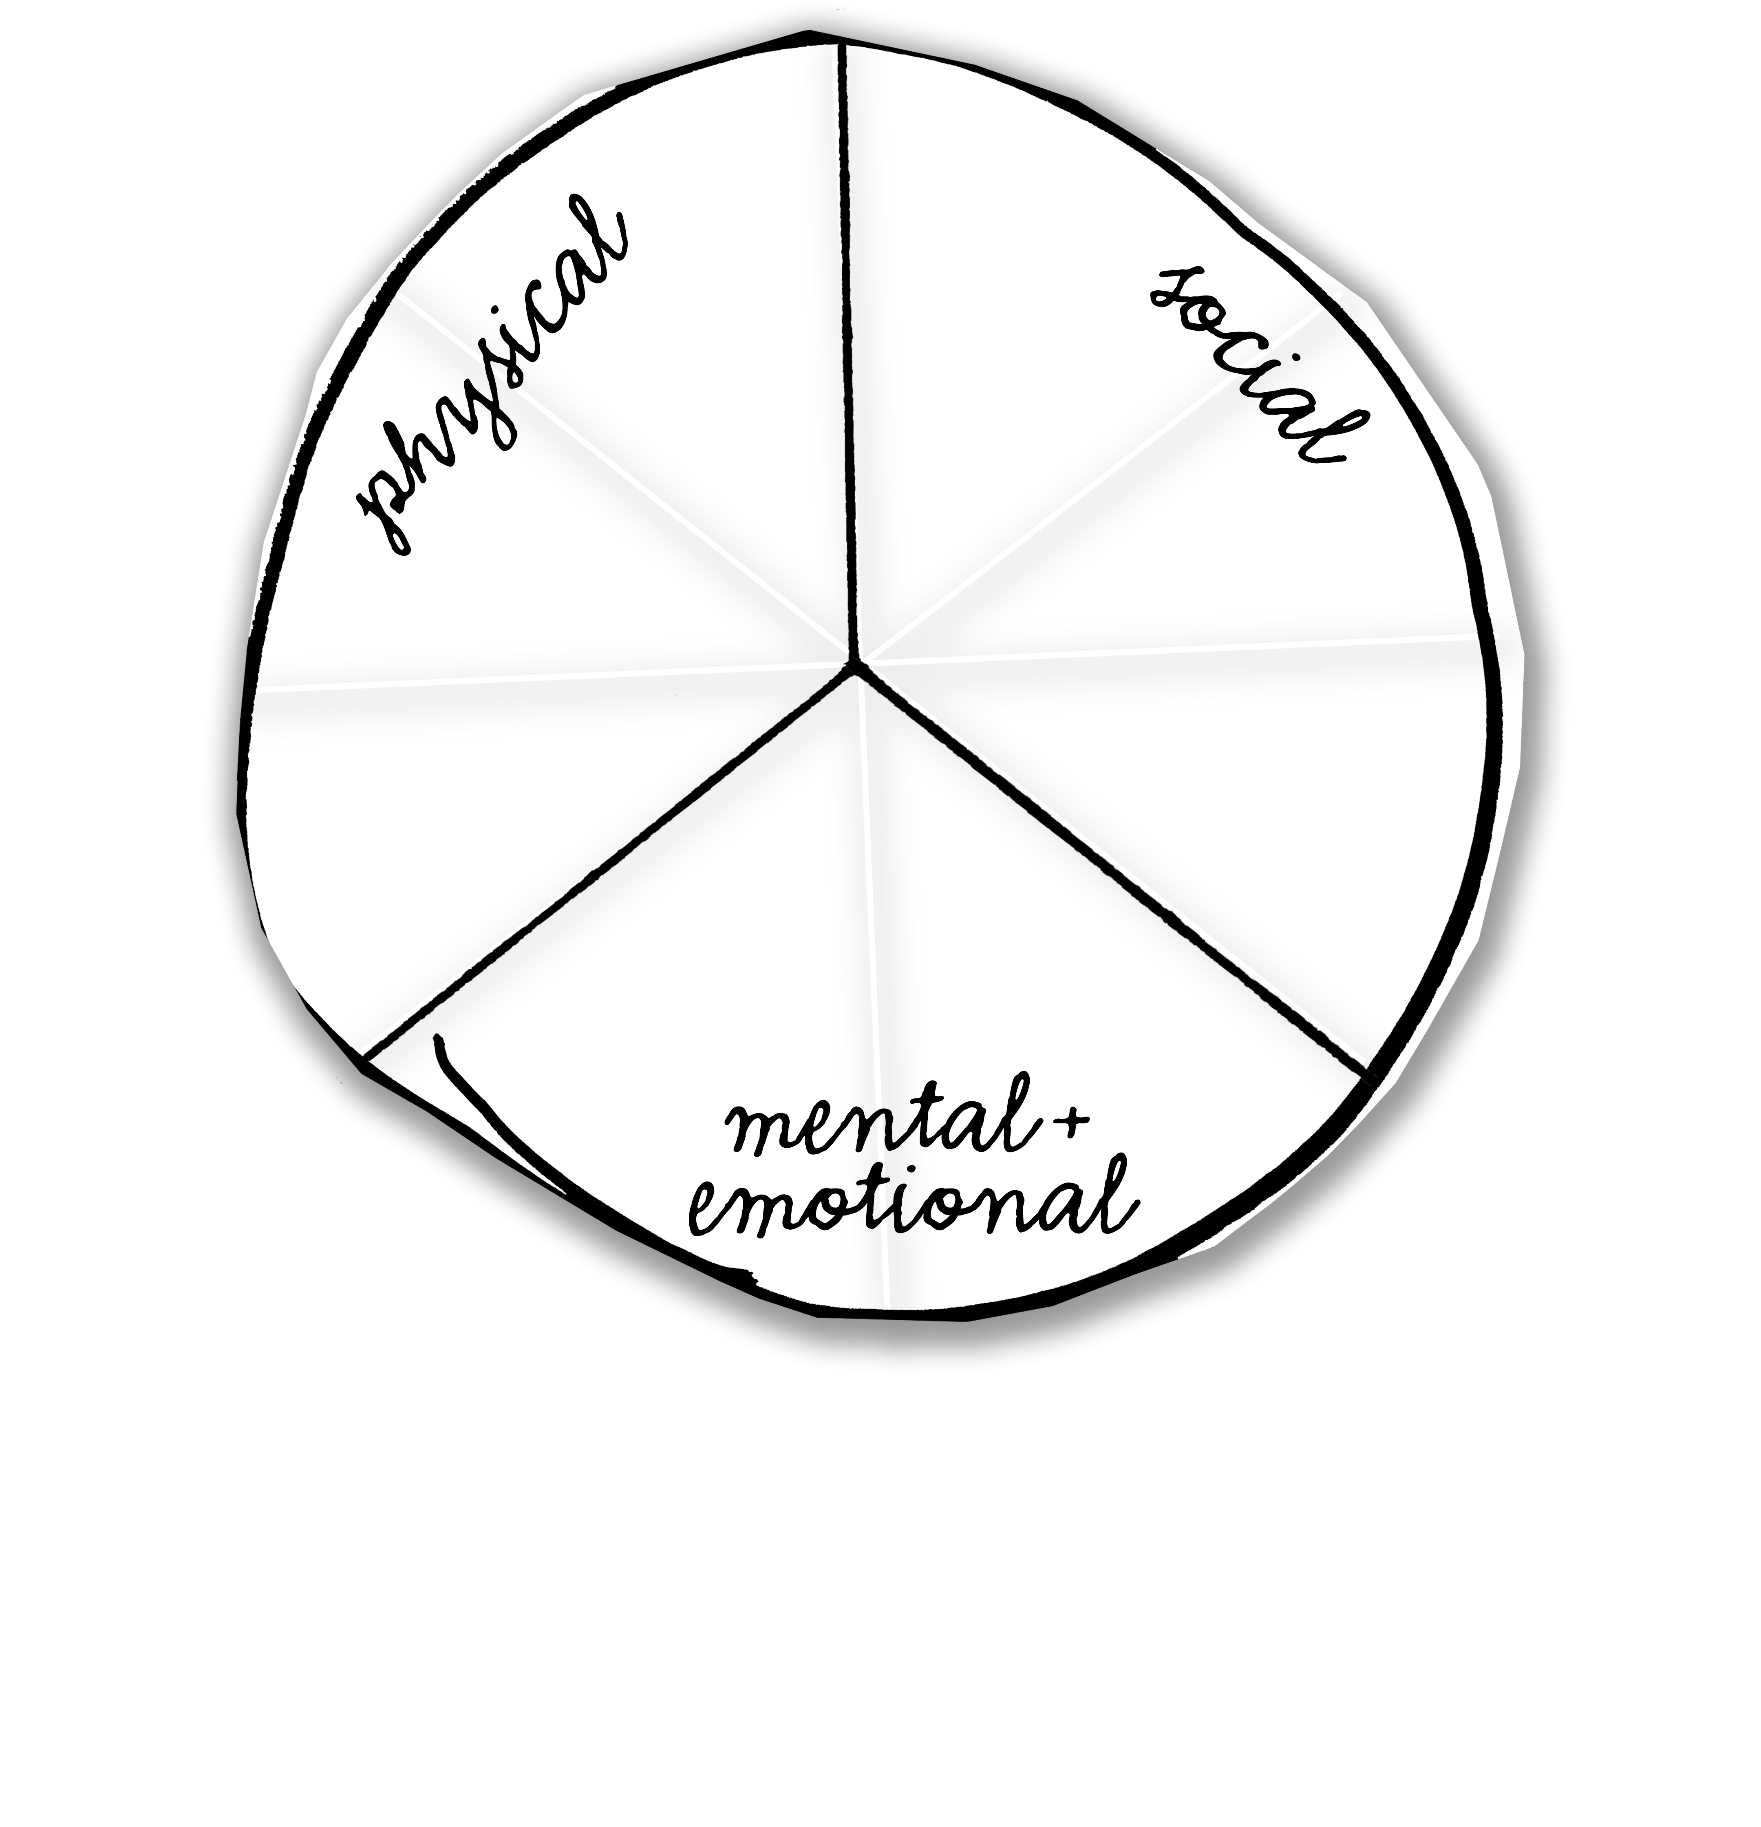
Cut, fold and divide.
Cut, fold and divide.

Slide 15
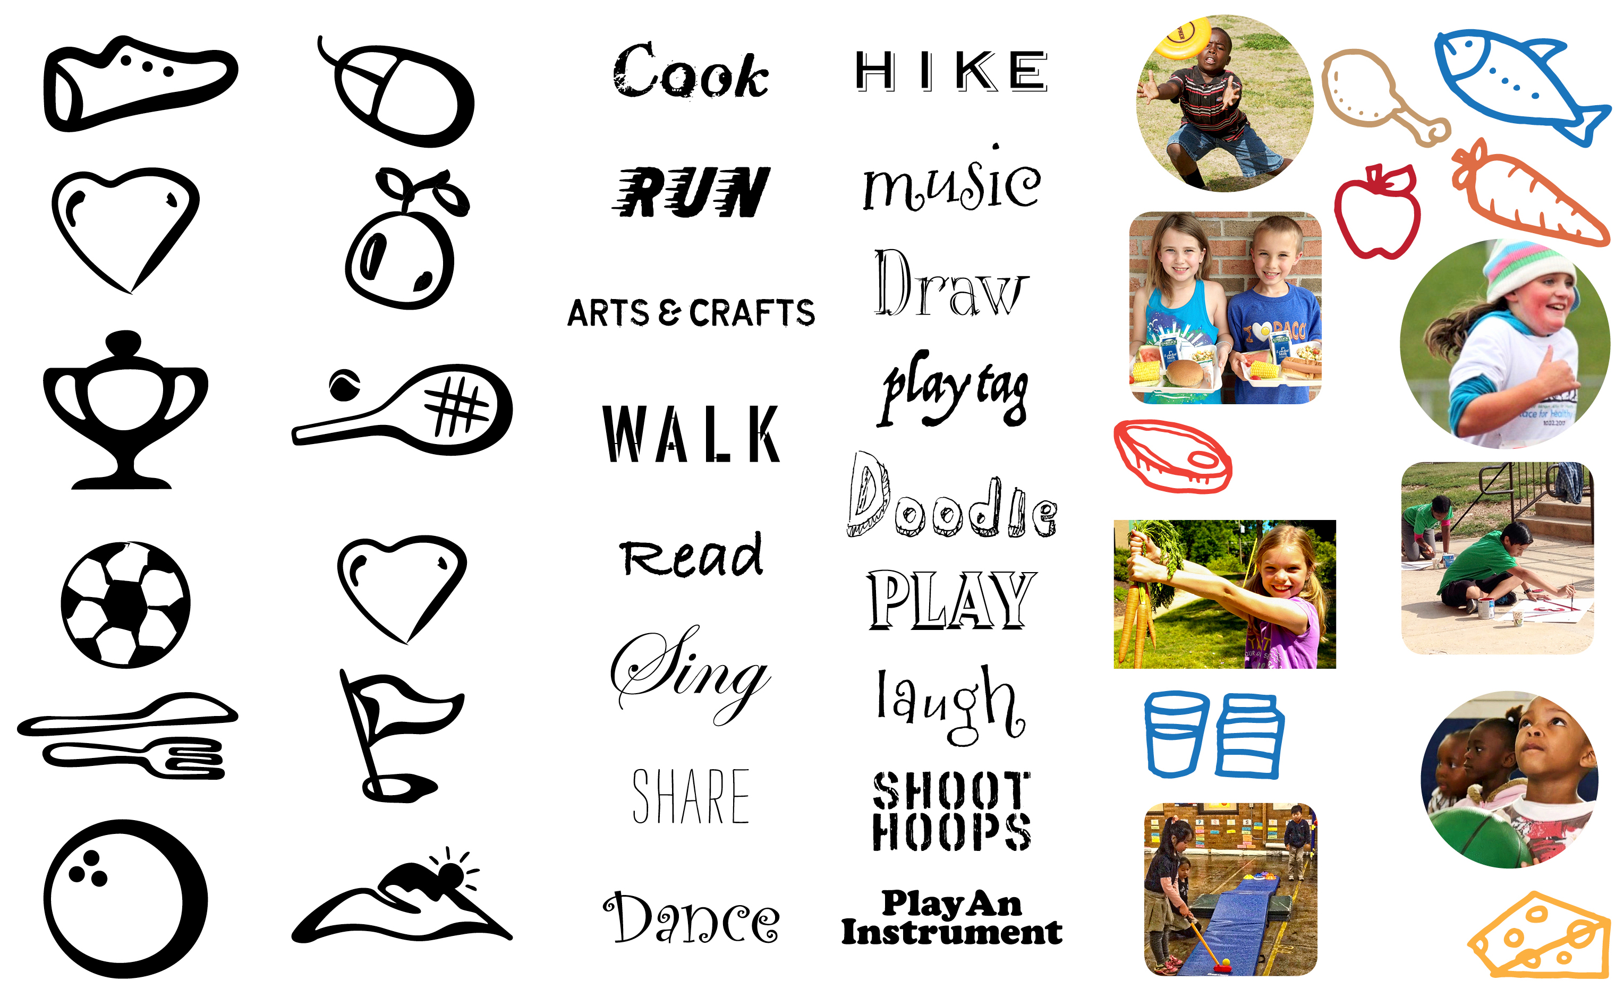
Activity: Make a Wheel of Wellness
Icons
Words
Pictures

