Slide 1

Curriculum Overview
Learn about the Together Counts program and philosophy — and how to integrate it in your classroom

Slide 2

Wellness: It’s Interconnected!

Slide 3
Table of Contents
Learning & Wellness: What’s the Link?
  Research, Stats and Q&A’s Slides 4 – 14
  About Together Counts Slides 15 – 16
  What Is Wellness? Slides 17 – 19
Together Counts: Curriculum Overview
  EVERY PART COUNTS Slides 22 – 26
  Physical, Social & Mental/Emotional Health
  EVERY BITE COUNTS Slides 27 – 30
  Nutrition and Meal Planning
  EVERY MOVE COUNTS Slides 31 – 35
  Physical Activity and Fun

Slide 4

Learning + Wellness : What’s the Link?
“Academic achievement and health are closely linked, and healthy students are more ready and able to learn. School districts and schools that create and sustain systemic supports for students’ physical, mental, and social health see a positive impact on academic performance, educational behavior, cognitive ability and attitude.”
Critical Connections: Health and Academics. Journal of School Health, 85(11), 740-58.
Source: Michael, S.L., Merlo, C.L., Basch, C.E., Wentzel K.R., Wechsler, H. (2015).

Slide 5
Q&A: Question
According to the Physical Activity Guidelines for Americans, kids and teens age 6–19 should get 60 or more minutes of physical activity* on at least 5 days per week.
* moderate-to-vigorous physical activity
Q: TAKE A GUESS: What percentage of this age group meets that goal?

Slide 6
Q&A: Answer
The answer is roughly one-fifth.
Only 21.6% of kids and teens attain 60 or more minutes of moderate-to-vigorous physical activity on 5 days per week.
That means 78.4% of kids and teens do not get enough exercise.

Slide 7
Q&A: Question
Childhood mental disorders affect many children and families. Boys and girls of all ages, ethnic/racial backgrounds, and living in all regions of the U.S. experience mental disorders.
Q: WHAT’S YOUR SENSE? What percentage of children and teens do you think have mental disorders?

Slide 8
Q&A: Answer
Roughly one-fifth.
It is estimated that 13–20 percent of American children (up to 1 out of 5) suffer from a diagnosable mental, emotional or behavioral disorder in a given year.
Children with mental disorders often have trouble learning in school, making friends, and building relationships later in life, according to a report from the CDC.

Slide 9
Food for Thought
Obesity in children and teens in the U.S. has more than tripled since the 1970s.
It's estimated that nearly 1 in 3 children and teens are overweight and 1 in 5 are obese.
In addition, studies since 2013 show a significant rise in severe obesity among children ages 2 to 5.

Slide 10

Food for Thought
Could increasing physical activity levels help with mental and emotional health? With childhood obesity and physical health? With academic performance?
How can you integrate physical and social wellness?
Could nutrition education help with physical health? With mental and emotional wellness?
Which of these aspects of health and wellness are connected? How so?

Slide 11

Learning + Wellness: What’s the Link?
Schools are the right place for a healthy start.
Schools play a critical role in promoting the health and safety of young people and helping them establish lifelong healthy behaviors.
Research shows that school health programs reduce the prevalence of health risk behaviors among young people and have a positive effect on academic performance.
Source: CDC

Slide 12
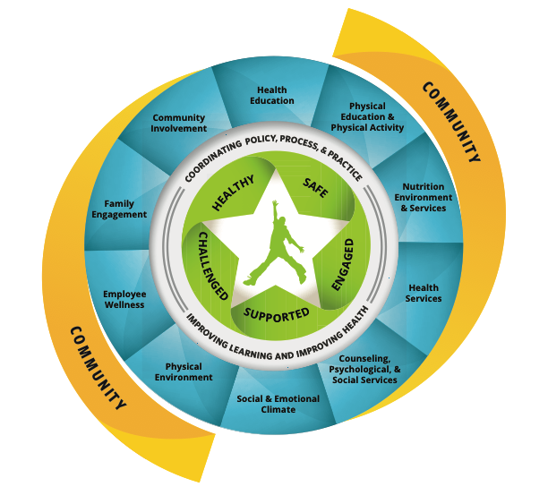
A Whole-Child Approach
The CDC’s Whole School, Whole Community, Whole Child model was designed to help prevent childhood obesity. It has recently been updated with an expanded “whole-child” approach. This new graphic illustrates how a child’s emotional, physical and academic development requires multiple components, such as:
Physical education and physical activity
Nutrition environment and services
School health services to support
physical, psychological, and
emotional health
Family and community engagement
– Source: CDC / ASCD

Slide 13
A Whole-Child Approach
The Need for an Expanded Model to School Health
This new collaborative approach to learning and health was created to achieve greater alignment, integration and collaboration between education and health — to improve each child’s cognitive, physical, social and emotional development.
– Source: CDC / ASCD

Slide 14

A Whole-Child Approach
Addressing these areas can help children achieve and maintain a healthy weight — and attitude about weight.
The “Whole Child” approach is an effort to transition from a focus on narrowly defined academic achievement to one that promotes the long-term development and success of all children.
– Source: CDC / ASCD

Slide 15

Together Counts: What’s new?
To align with the CDC’s updated WSCC approach, we’ve added features such as:
New curriculum section on “Thoughts & Feelings” for grades K–2 and 3–5
New model and visual aids to emphasize all parts of wellness: Physical, Social and Mental & Emotional
New emphasis on the social and emotional climate in classrooms and schools
New tools and creative ideas for making and tracking your own wellness goals
Updated lessons and activities for Physical Wellness (covering both Physical Activity & Nutrition)

Slide 16
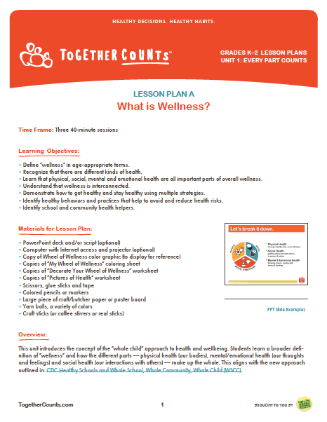
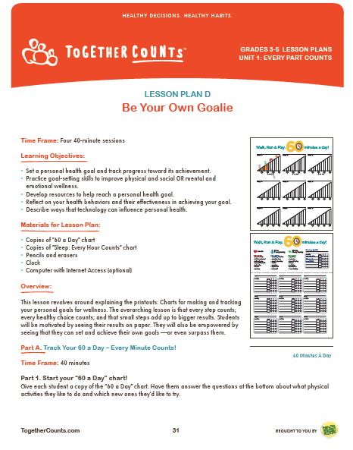

Together Counts: What’s included?
Together Counts provides lessons, discussion guides, after school materials, family resources and hands-on activities that promote a “whole-child” approach to wellness. All materials are standards-aligned and designed to teach and reinforce the importance of working toward an active, healthy lifestyle!

Slide 17
What Is Wellness?
What is wellness? And how do we teach it in our classrooms?
Let Together Counts be
your guide.

Slide 18
What Is Wellness?
Here’s how we teach it in our lesson plans.

Slide 19
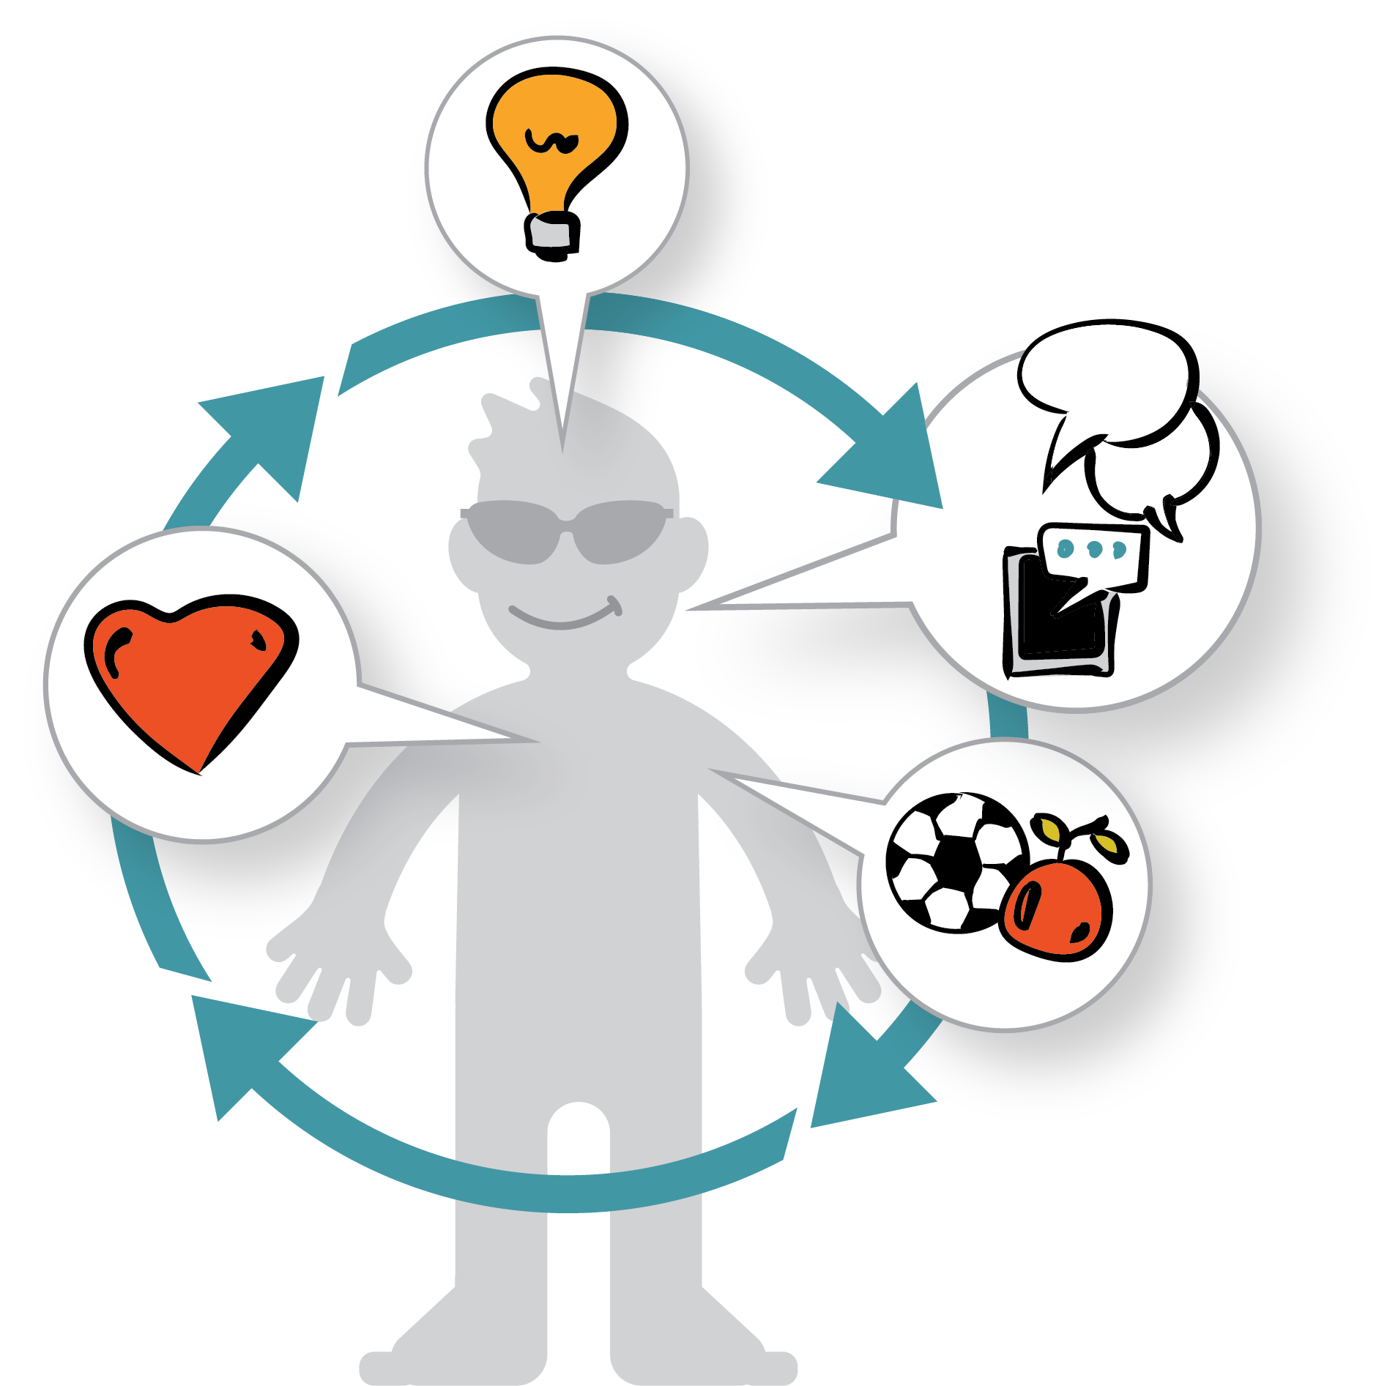
What Is Wellness?
Wellness is about being
healthy in heart, mind and body. It focuses on the whole person, not just one part.

Slide 20
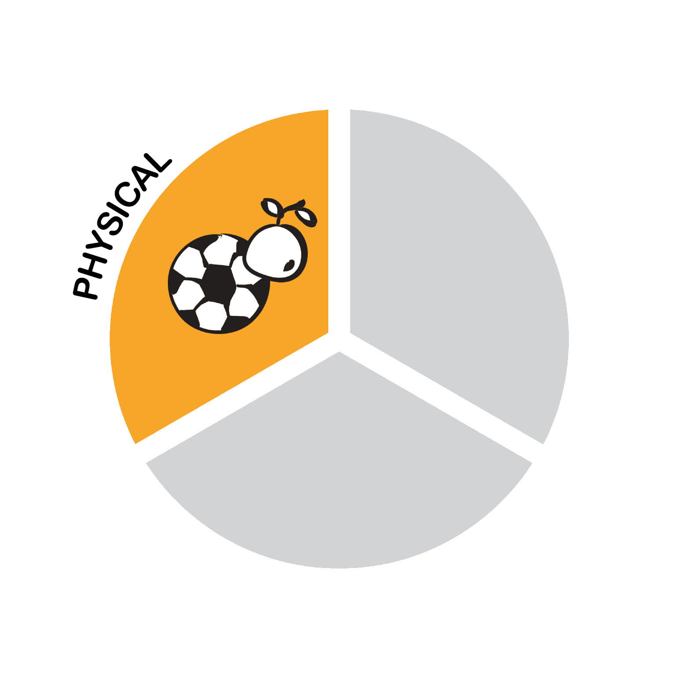
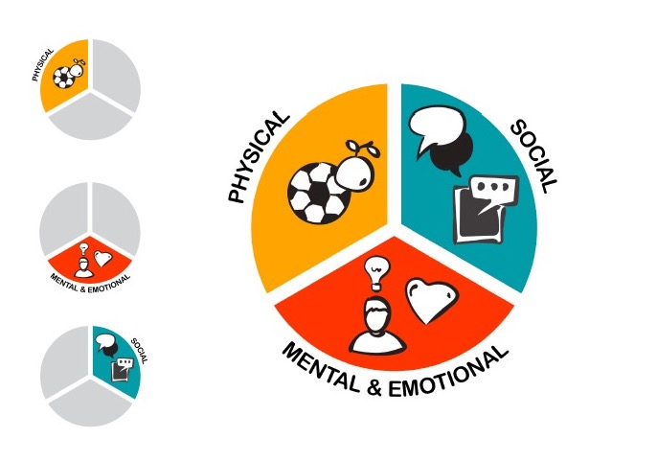


Wellness: The 3 Main Types
Lessons focus on 3 main types of wellness:

Slide 21
Together Counts: The 3 Units
Unit 1: EVERY PART COUNTS
What is Wellness?
Thoughts & Feelings
Every Choice Counts
Be Your Own Goalie
Unit 2: EVERY BITE COUNTS
Fill Your Plates
Food Scientists
Eat to the Beat
Unit 3: EVERY MOVE COUNTS
Big Goals, Mini Goals
Desk Exercises
Just Dance!

Slide 22
Unit 1: EVERY PART COUNTS
LESSON PLANS
What is Wellness?
Thoughts & Feelings
Every Choice Counts
Be Your Own Goalie
  Physical Activity: Every Minute Counts
  Water Intake: Every Cup Counts
  Screen Time: Every Minute Counts
  Sleep: Every Hour Counts
SUMMARY: Students learn about the different components that contribute to overall wellness: physical, social, and mental and emotional health. Each part is important, and every part counts!

Slide 23
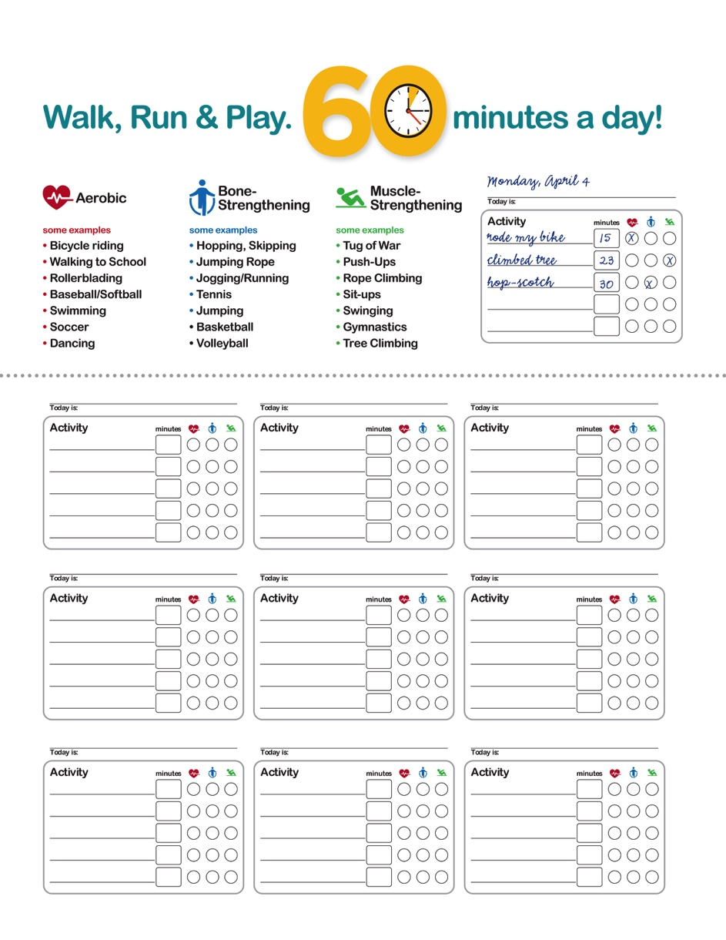
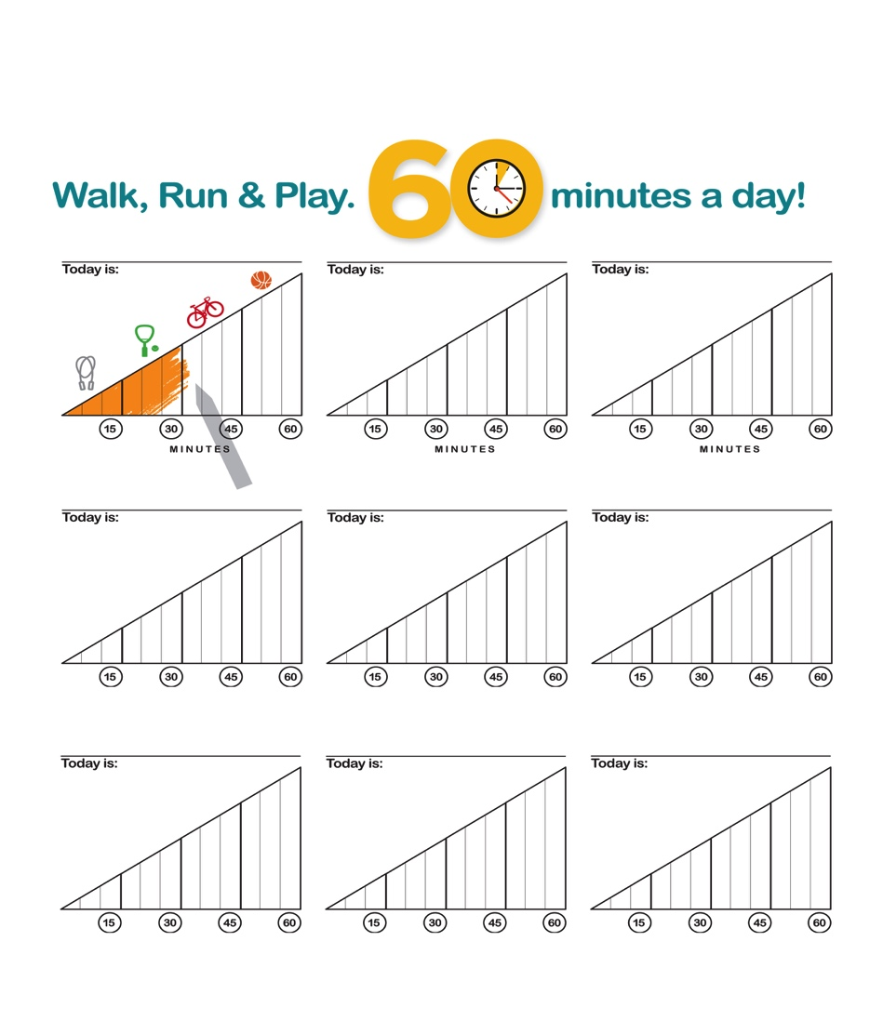
Unit 1: Goal Charts
“Be Your Own Goalie” lesson includes 4 different charts:

Slide 24

Unit 1: Thoughts + Feelings
Creative, age-appropriate lessons focus on social, mental and emotional wellness.

Slide 25


Unit 1: Social, Mental & Emotional Health
Kindness, empathy, self-esteem, stress management and social skills are enhanced through discussions and activities.

Slide 26
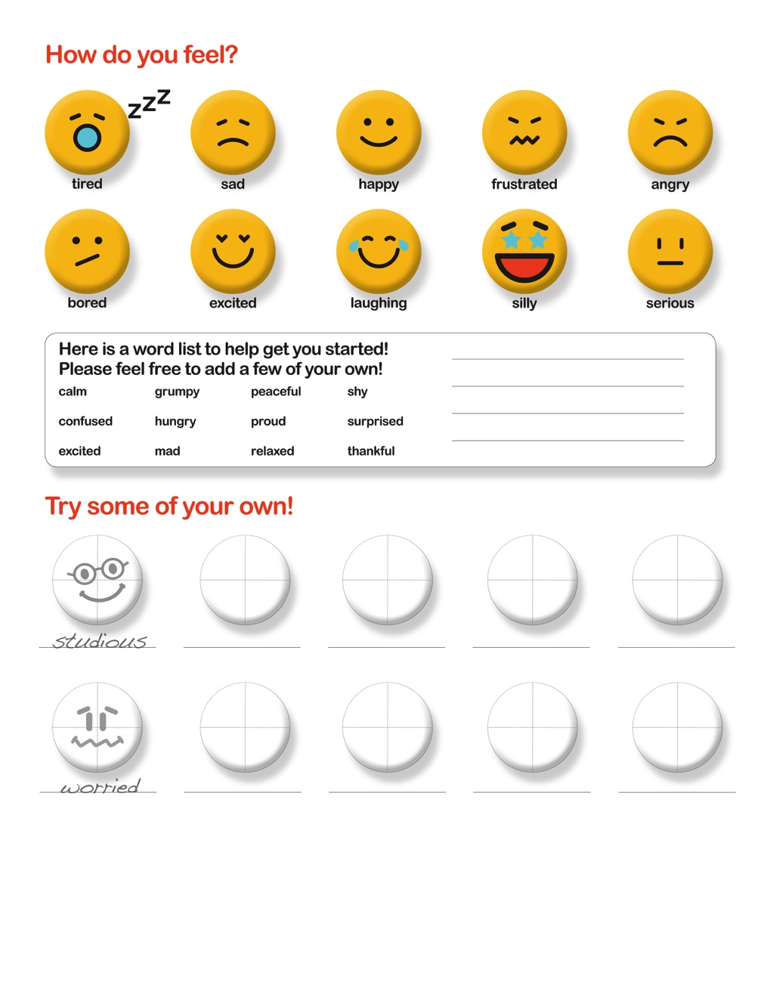
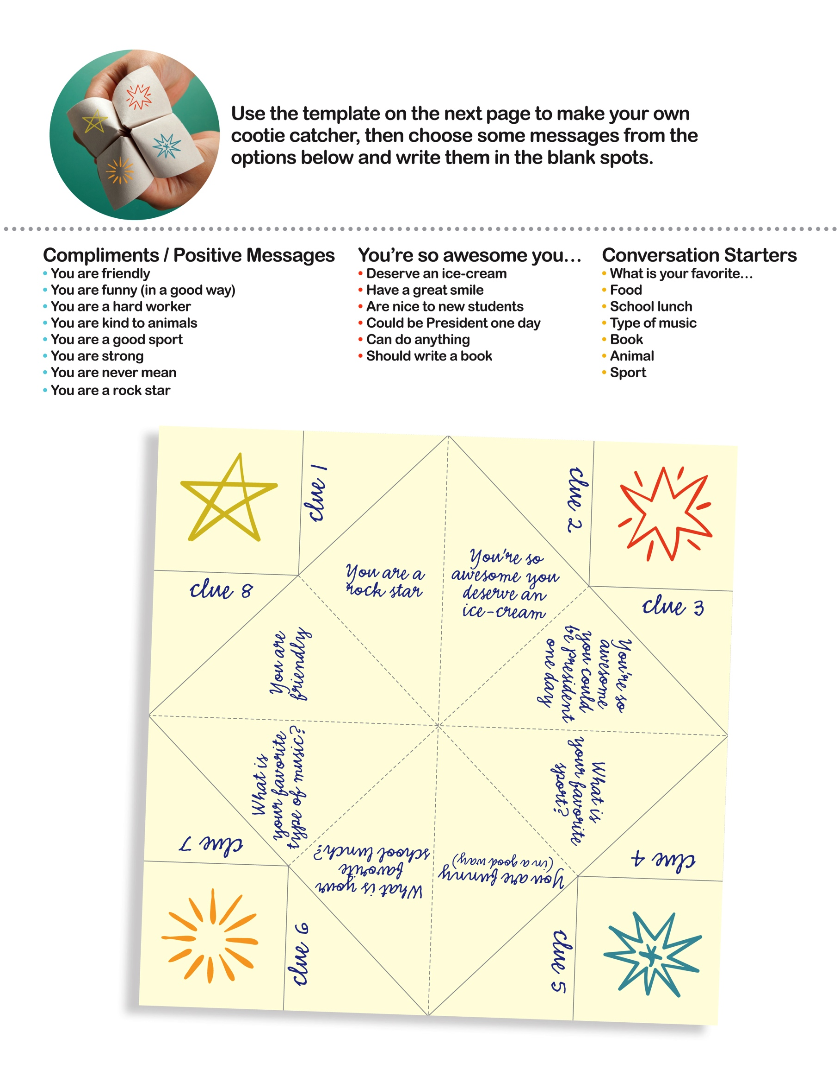
Unit 1: Thoughts & Feelings
Fun activities include “Make-Your-Own Emojis” and “Cootie Catchers” for expressing feelings, sharing compliments and building social connections.

Slide 27

Unit 2: EVERY BITE COUNTS
LESSON PLANS
Fill Your Plates
Food Scientists
Eat to the Beat
SUMMARY: Students are introduced to the MyPlate concept, the five food groups, and the vital nutrients we get from a variety of foods. Through fun, science-based activities they learn that “everything you eat and drink matters.”

Slide 28

Unit 2: EVERY BITE COUNTS
Students are empowered to make smart choices as part of a healthy, active lifestyle.

Slide 29
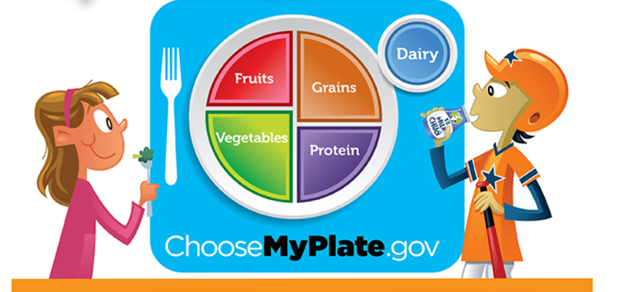
Unit 2: EVERY BITE COUNTS
All nutrition and meal-planning activities align with the USDA’s MyPlate recommendations.

Slide 30


Unit 2: EVERY BITE COUNTS
Activities like “Eat to the Beat” and “Head Chef Challenge” encourage kids to get in the kitchen and try new foods.

Slide 31
Unit 3: EVERY MOVE COUNTS
Big Goals, Mini Goals
Desk Exercises
Just Dance!
SUMMARY: Students learn that physical activity is a critical part of wellness, and that when it comes to activity choices, there’s something for everyone! They track goals for daily physical activity and are encouraged to develop healthy exercise habits as part of an active lifestyle.

Slide 32

Unit 3: EVERY MOVE COUNTS
Physical activity can be integrated throughout the day — with desk exercises, one-minute activity bursts and dance.

Slide 33
Unit 3: Big Goals, Mini Goals
Physical Activity Charts encourage kids to set, track and achieve measurable goals.

Slide 34

Unit 3: EVERY MOVE COUNTS
Students learn a range of activities that can be easily done at recess, at a local park or playground, or at home — and are encouraged to teach them to family members as well.

Slide 35

Together Counts
When it comes to wellness, we’re all in this together!

