Slide 1

Training Activities
Group Exercises for Teachers
Learning the Curriculum

Slide 2
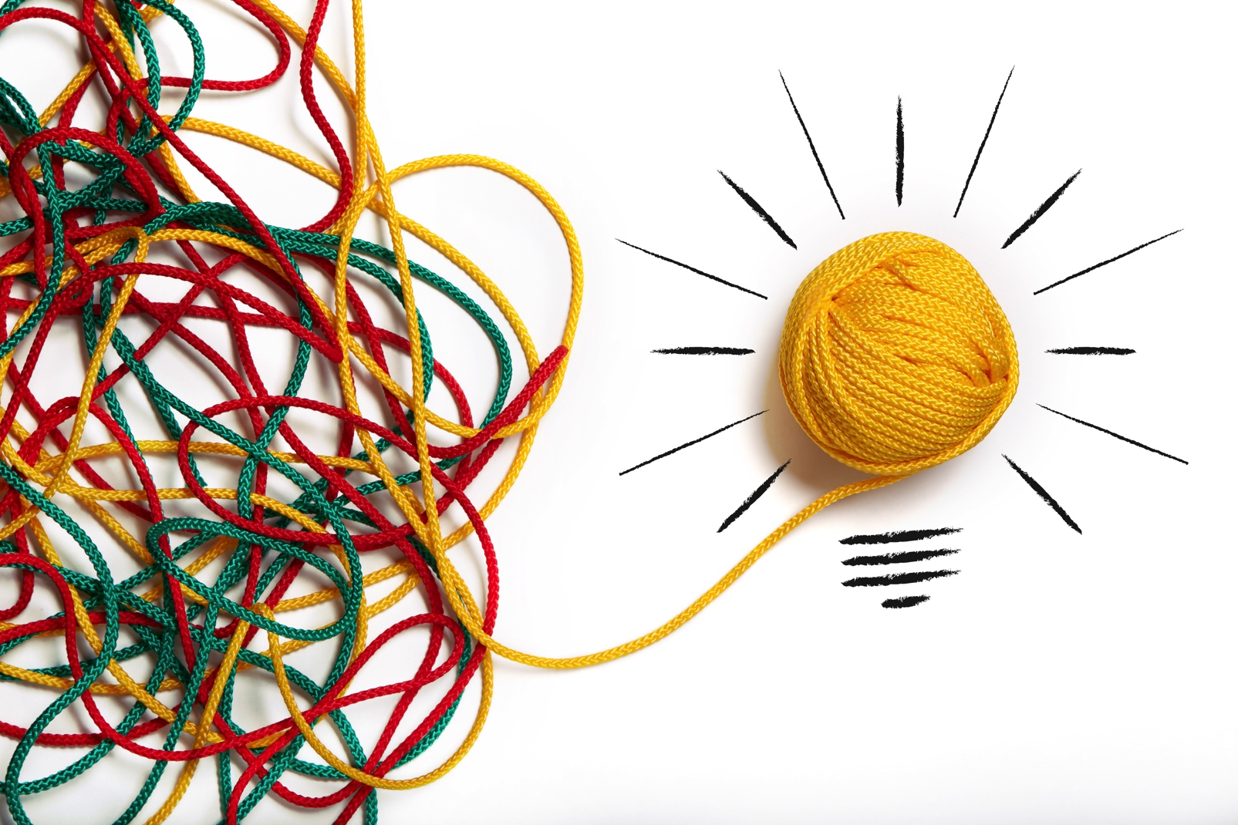
Let’s Get Inspired!
UNIT 1: EVERY PART COUNTS
Do the Wellness Stretch 5
Categorize & Connect 12
(worksheet activity)
Spin a Wellness Web 13
UNIT 2: EVERY BITE COUNTS
Snack Break 18
Meal Planning 18
(worksheet activity)
UNIT 3: EVERY MOVE COUNTS
Overview 20
Desk Exercises 23

Slide 3
Let’s Learn By Doing
These are a sample of activities found in the Together Counts curriculum for Grades 3–5. You’ll find variations of these adapted for Grades K–2 as well.
We’ll do some of these today, so we can teach our students how to do them back in the classroom.

Slide 4
Unit 1: Every Part Counts
All lessons and activities in this unit focus on one essential question: What is wellness? Let’s explore and find out.
This unit introduces the concept of holistic health (focusing on the “whole child”). Students learn a broader definition of “wellness” and how the different components — physical, social, and mental/emotional — interconnect and make up the whole.

Slide 5
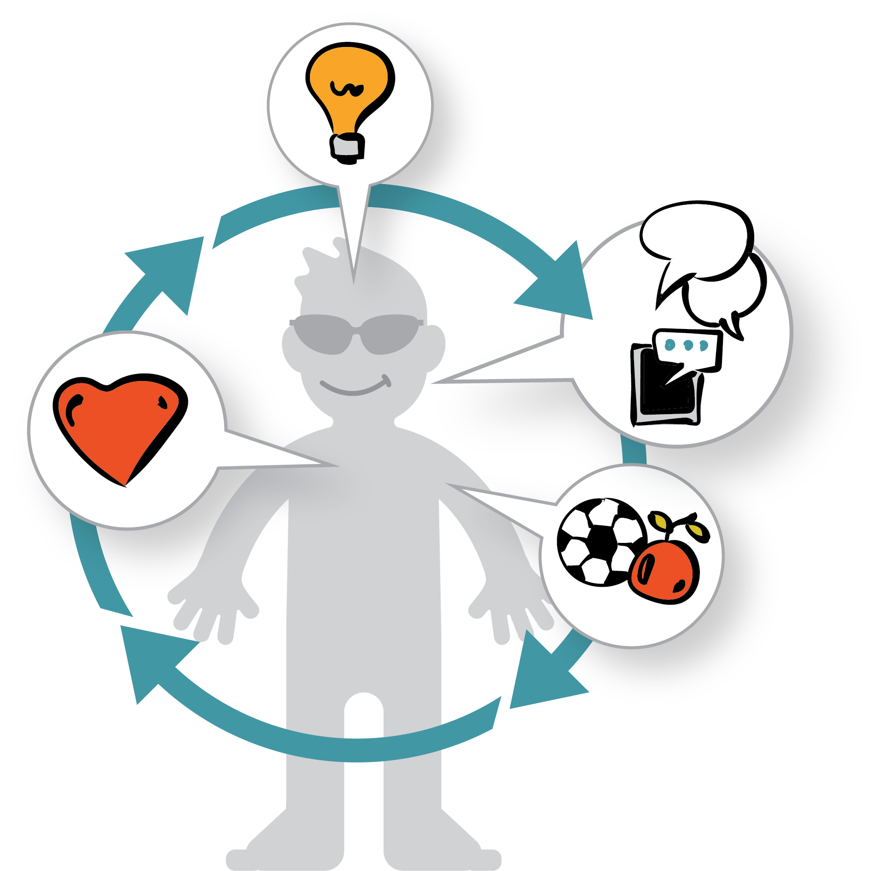
What Is Wellness?
Wellness is about being
healthy in heart, mind and body. It focuses on the whole person, not just one part.

Slide 6
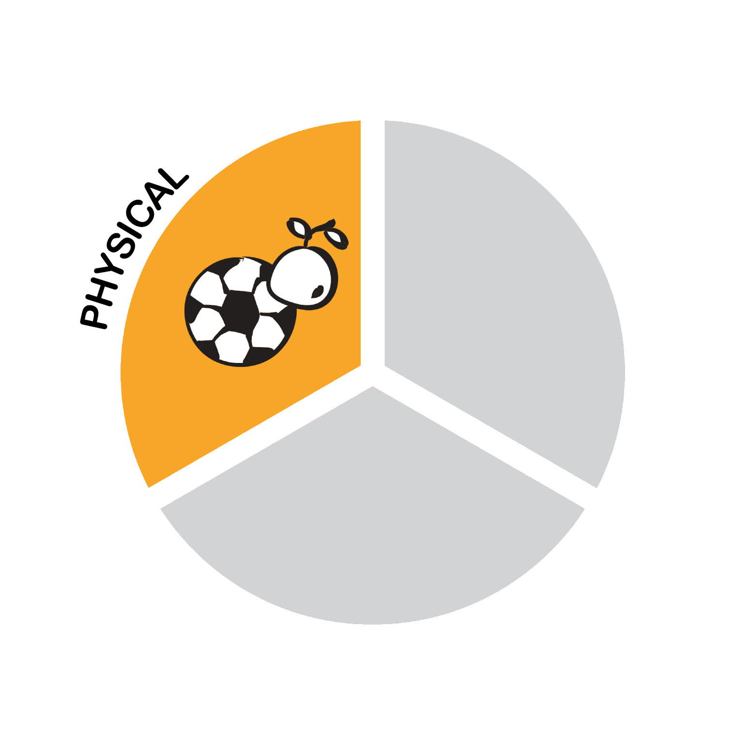
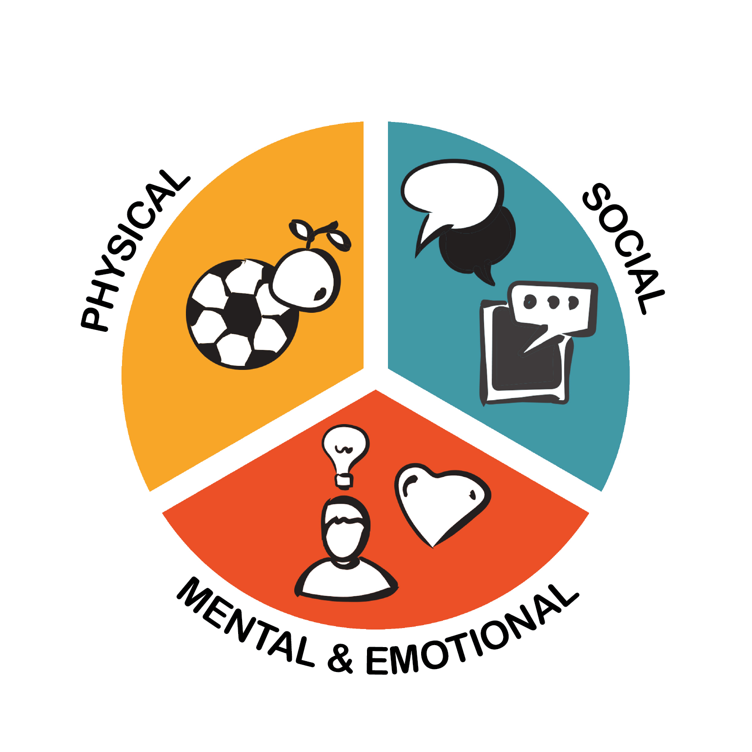
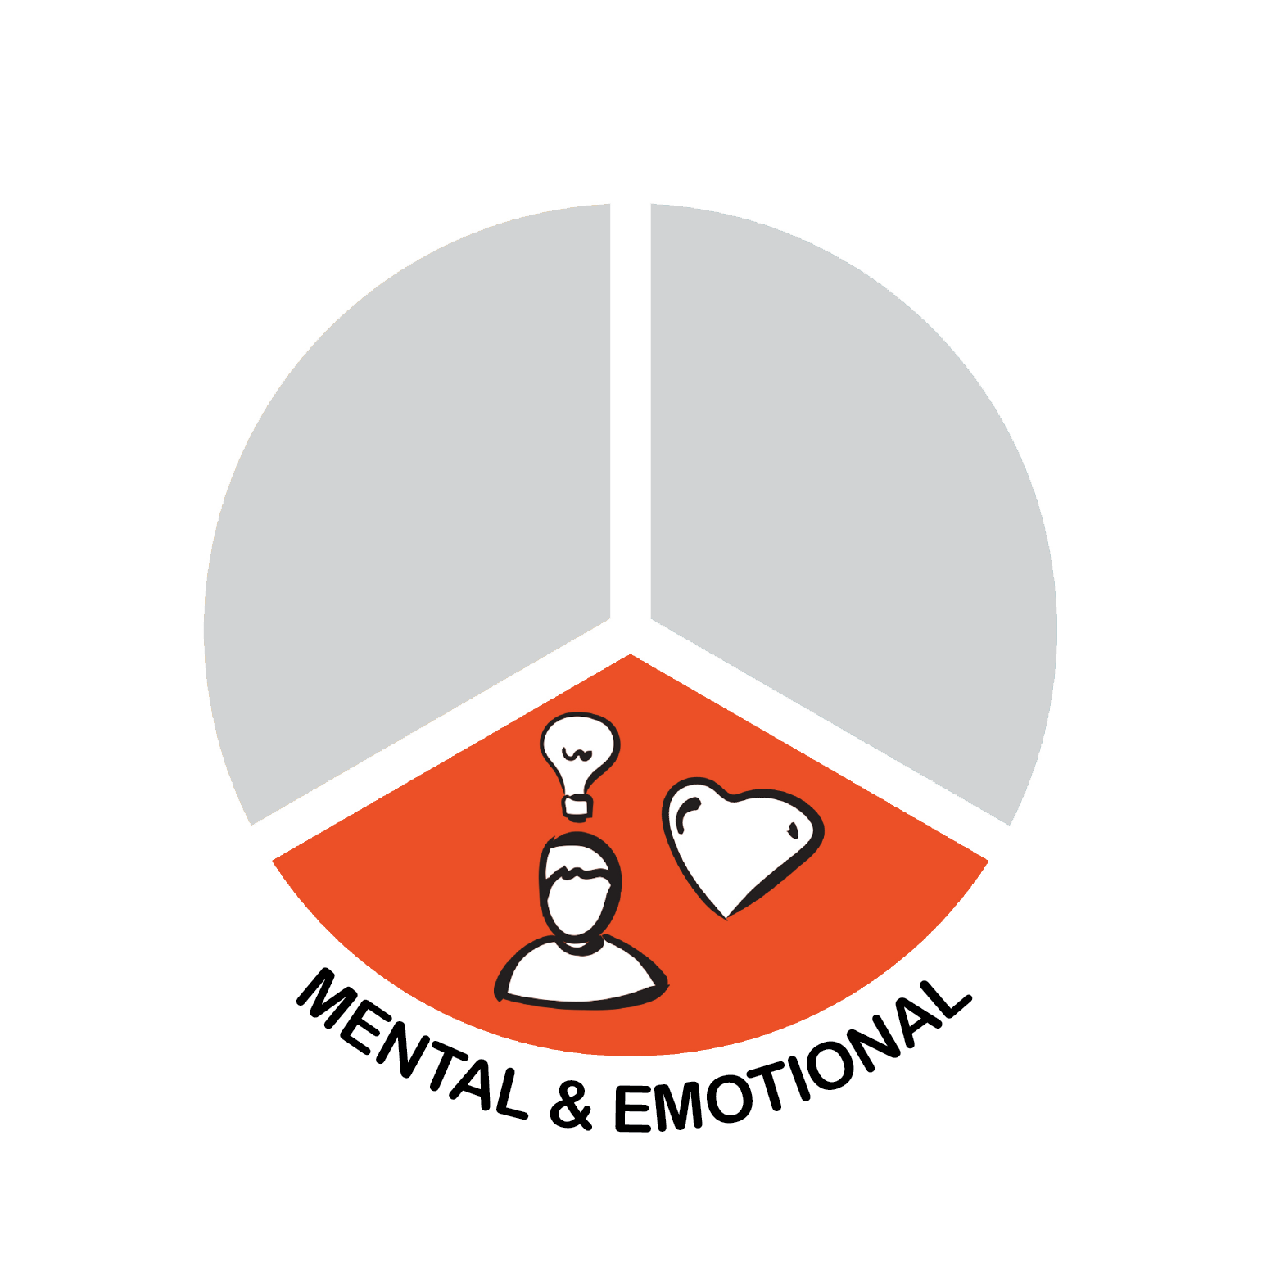
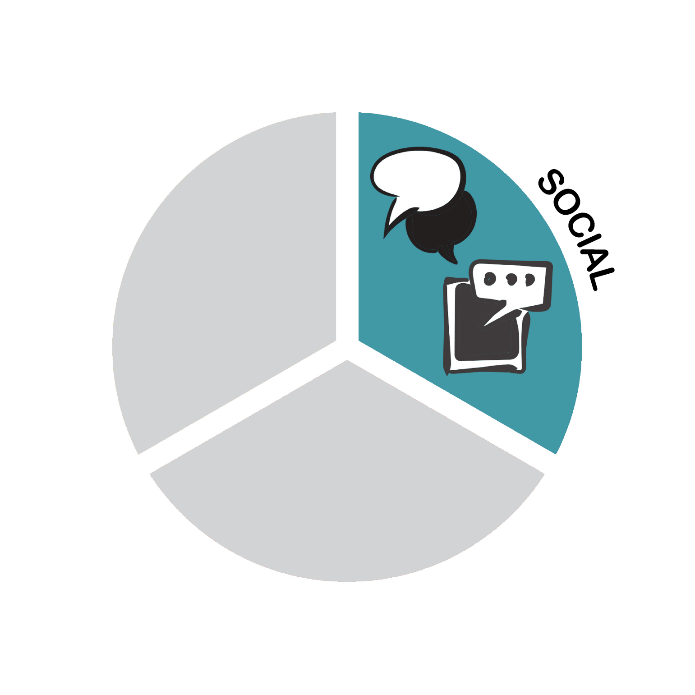
Wellness: Every Part Counts!
Wellness is about:
Physical
Social and
Mental & Emotional Health
All parts are important, and every part counts!

Slide 7
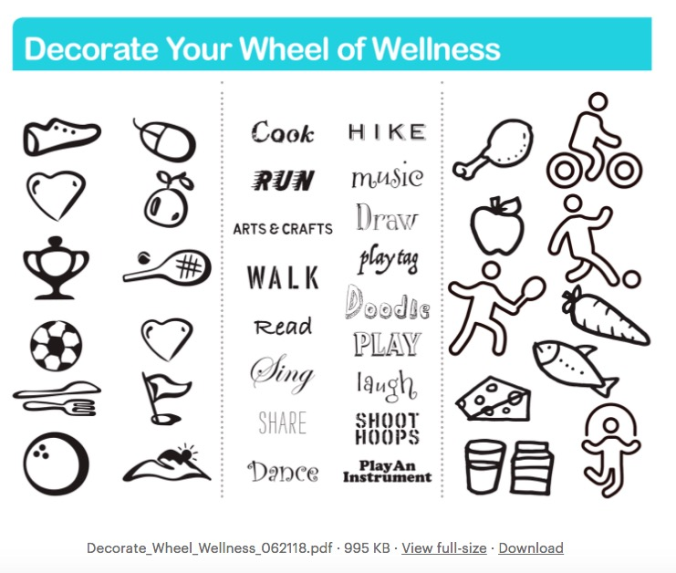
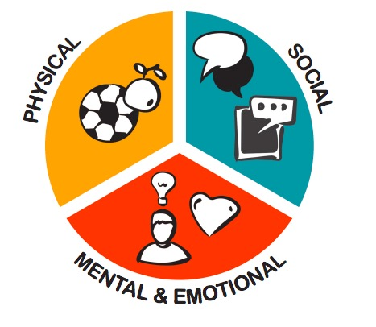
Make-Your-Own Wheel of Wellness
Students begin the unit by making their own “Wheel of Wellness,” following the basic structure in the Together Counts graphic shown here.

Slide 8
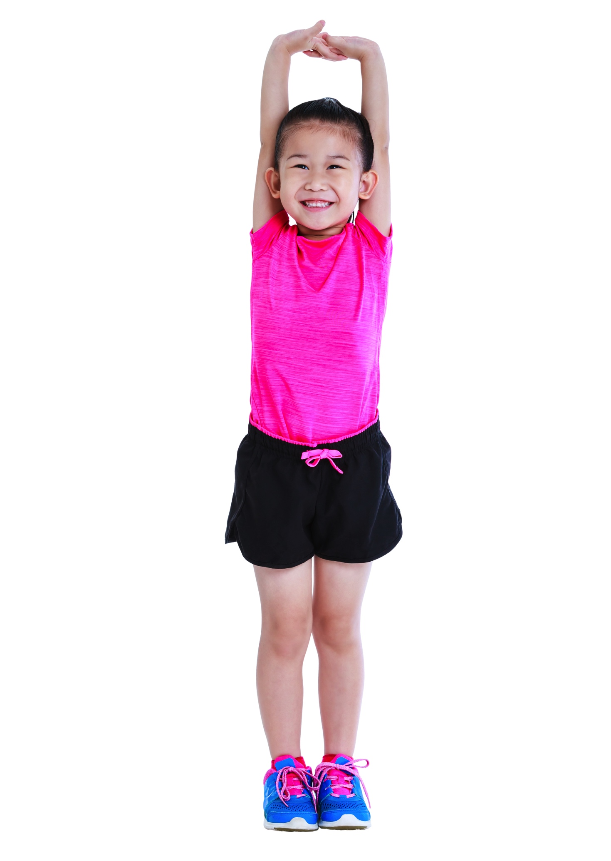
Let’s Do the Wellness Stretch!
Let’s start with a warm-up exercise called the Wellness Stretch. It’s designed for K–2 but relates to all ages!
Stand up next to your chair. Stretch out your arms to make sure you’ve got enough personal space on either side.
Put two hands on your head.
Now two hands on your heart.
Notes:
Let’s do the movements first, and then we’ll add the words.

Slide 9

Let’s Do the Wellness Stretch!
Put your hands together in front of your heart, slowly raise them up over your head, and then sweep down to your sides, making a large heart-shaped motion.
Do it one more time. Imagine you’re drawing a big
heart shape around your body.

Slide 10
Let’s Do the Wellness Stretch!
Wellness is about having a
healthy mind (two hands on your head)
healthy feelings (two hands on your heart)
and a healthy body (put hands
together, raise them up and
around, sweeping down to your
sides, making a large
heart-shaped motion)
“Wellness is about the WHOLE person.”
Notes:
Now let’s do that again, while saying these words when I point to each part: healthy mind, healthy feelings and healthy body. [Trainers: After the last time, say:]
“Whoops, we’re not finished. There’s one more part – our social health! Turn to the teacher to your right and shake their hand. Now turn to the classmate on your left and do the same. Wellness is about having healthy friendships, too!”

Slide 11
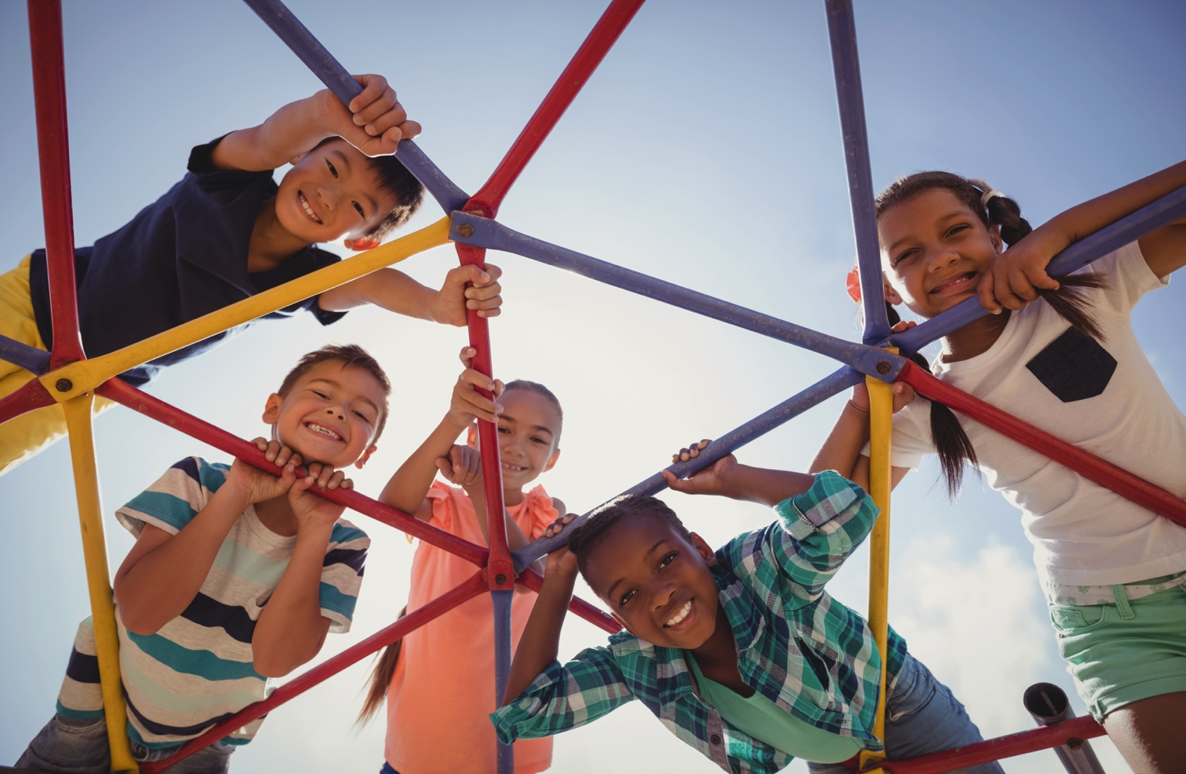
Wellness Is Interconnected!
Which is which?
Which type of activities fit into which wellness categories? Let’s look at the “Categorize & Connect” worksheet and brainstorm together.
Notes:
Distribute copies of the “Categorize & Connect” worksheet and talk through the worksheet together.

Slide 12
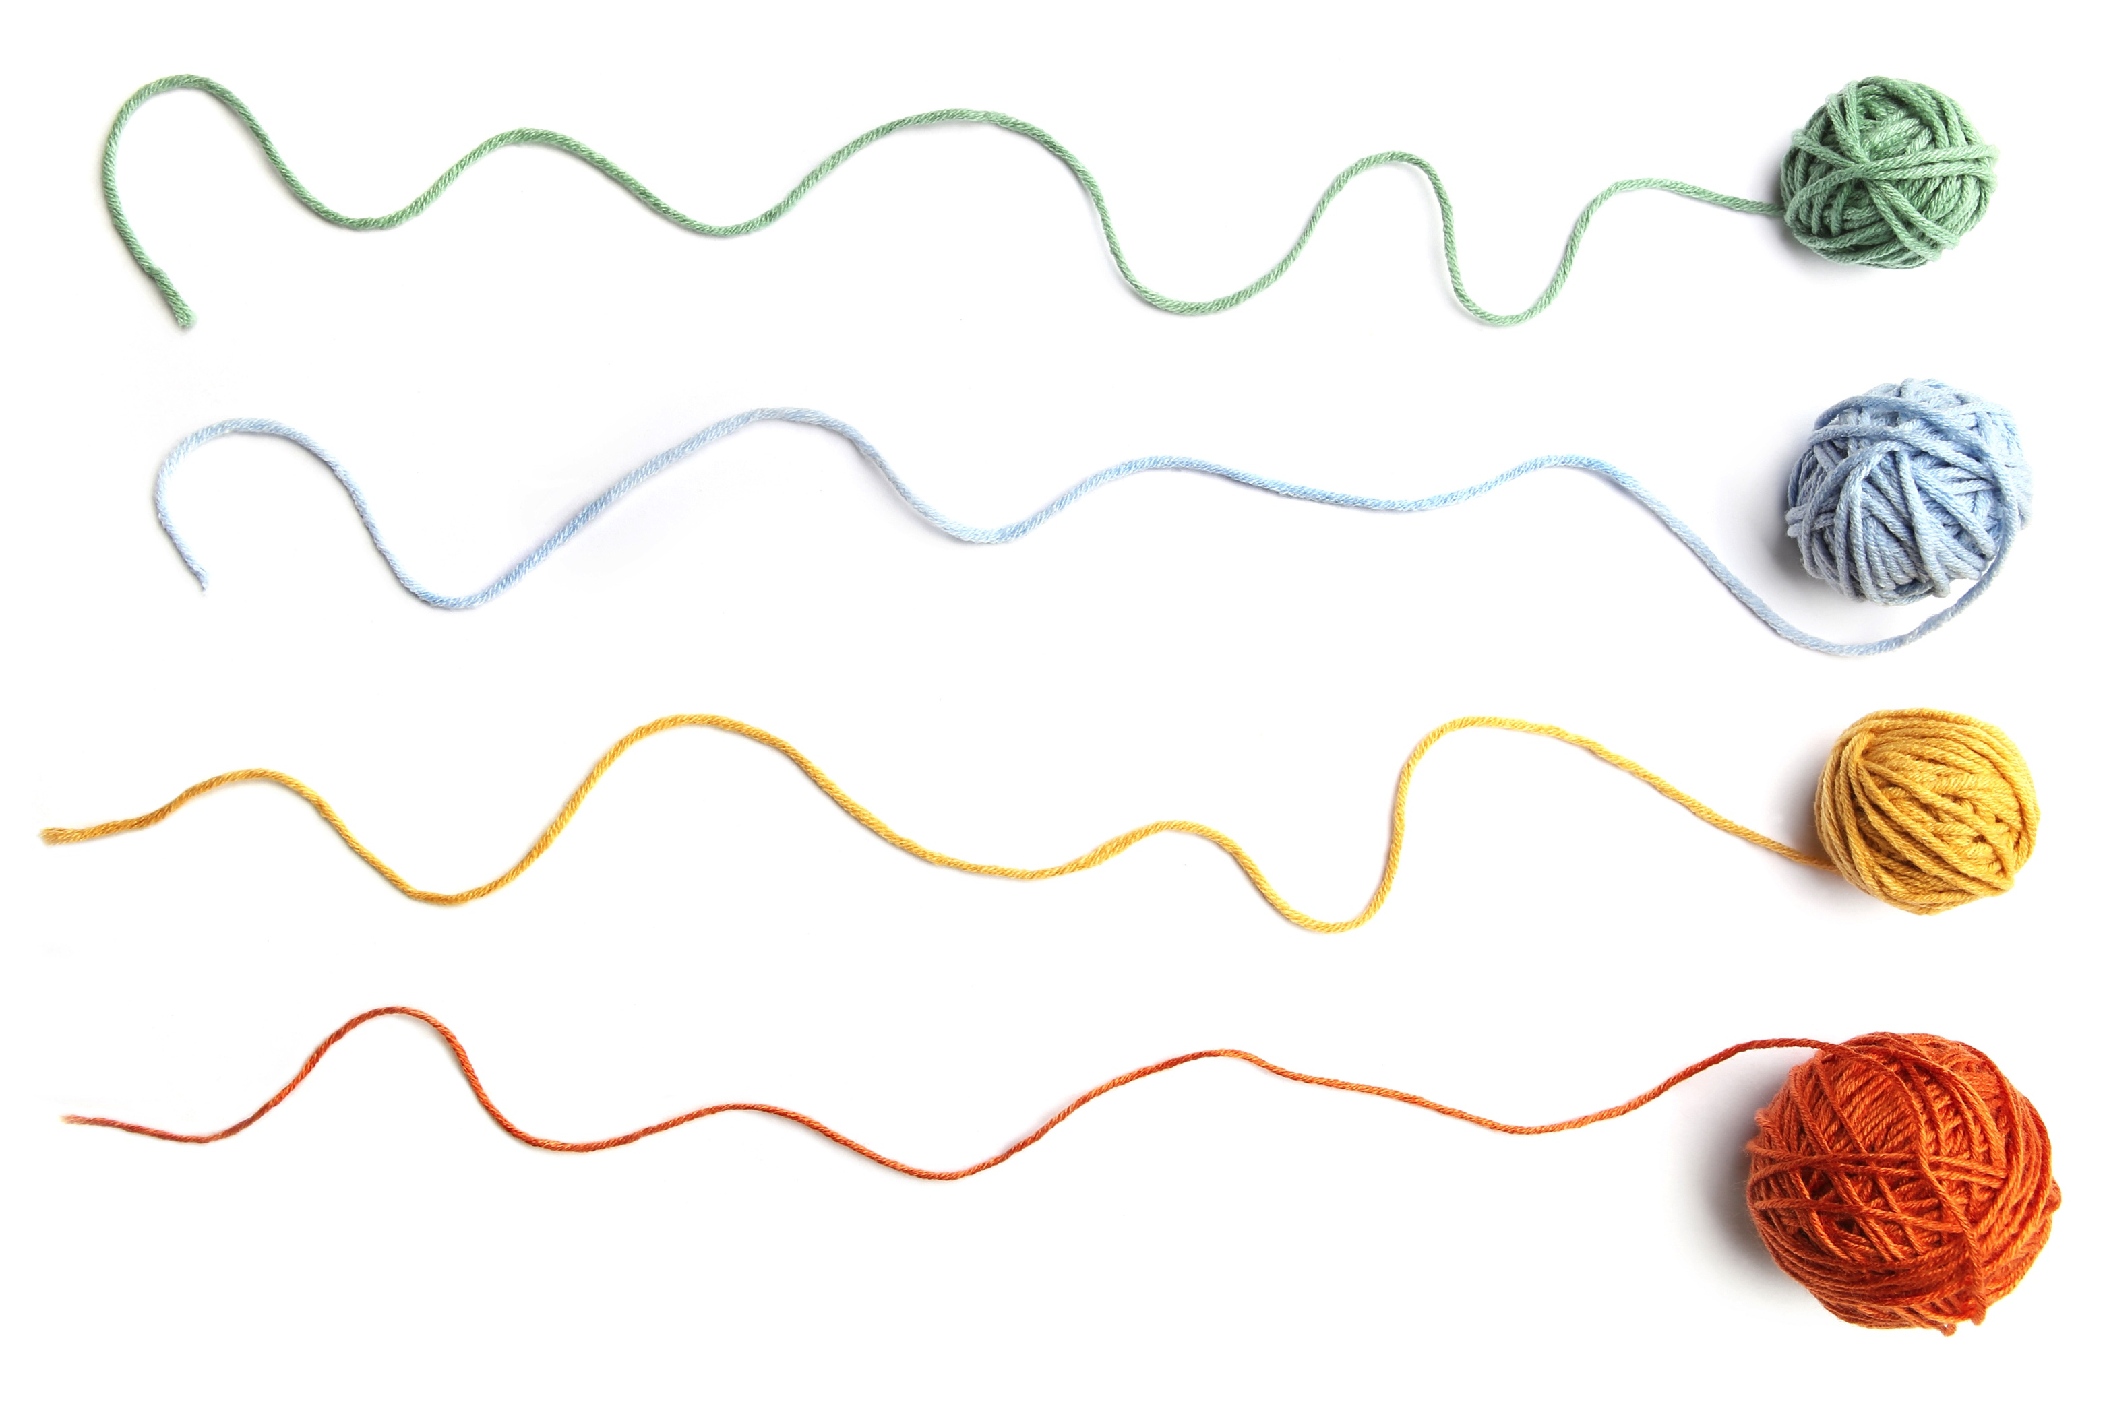
Spin a Wellness Web
How is wellness interconnected?
Let’s divide into 3 groups to represent the 3 parts of wellness:
  The P group for Physical
  The S group for Social
  The M&E group for
  Mental & Emotional
Notes:
After making labels, ask for some volunteers, one from each wellness category, to come to the front of the class to help with a demonstration.
In this activity, you’re going to toss the yarn ball from person to person to spin a web.
We’ll start with some small group webs and then do a big web with the whole class.

Slide 13

Spin a Wellness Web
Make a label with your group’s letter to wear on your shirt: P, S or M&E
In this activity, you’re going to toss the yarn ball from person to person to spin a web. We’ll start with some small group webs and then do a big web with the whole class.
Notes:
Use a Post-It note or a scrap of paper to make your label. Draw the letter with a marker, and then tape it onto your shirt to make sure it doesn’t fall off.
I’ll need some volunteers, one from each wellness category, to help with a demonstration.

Slide 14
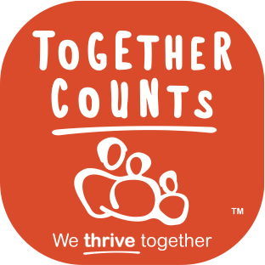
Spin a Wellness Web
Example #1: Being active for 60 minutes a day.
  In which category does this belong? Anywhere else?
Example #2: Drinking enough water every day.
  In which category does this belong? Anywhere else?
Example #3: Getting too much screen time.
  In which category does this belong? Anywhere else?
Notes:
I’m going to name an activity, and then you’re going to tell me which category you think it belongs in. Think: Where would you place it on your Wheel of Wellness?
Here’s example #1: Being physically active for 60 minutes a day. Where does this example belong?
Answer: Physical? Yes, it could go in the Physical Health category. Regular physical activity has a positive effect on our physical health. So I’ll throw it to “P.”
[Throw yarn ball to P student.]
Where else could it go? Let me read this to give us a clue: Vigorous physical activity is good for your muscles, your bones and your heart and lungs. Also, kids who are physically active at least 60 minutes each day sleep better. More sleep means they’re more alert and do better in school. They're also better able to handle stress and emotional challenges — like studying for a test.
Answer: The Mental & Emotional Health category? Yes!
[Instruct P student to throw yarn ball to M&E student.] Explain: Regular physical activity has a positive effect on our mental & emotional health. It helps relieve stress, it burns energy, and clears your head. It also gives you a boost of energy to improve your mood. Where else could the yarn go?
Answer: Social? Yes, if you spend that time playing with others, it’s a social activity. [Instruct M&E student to throw yarn ball to S student.] Explain: What are some examples? Playing tag or running around on the playground, going to a gymnastics class, swim lesson or sports practice — those are all social activities. Learning teamwork, cooperation, playing with friends and having fun all have a positive effect on our social health.

Slide 15
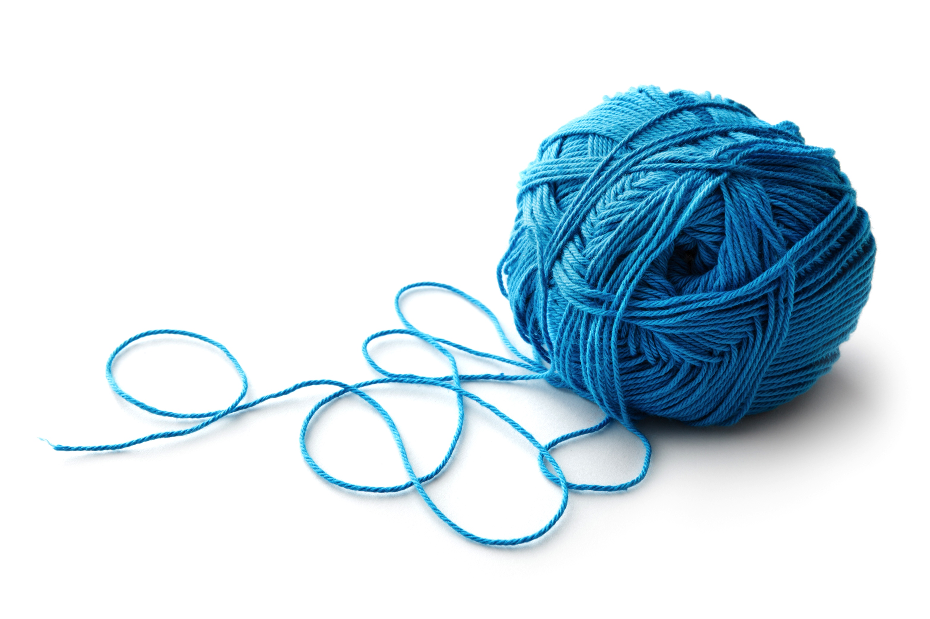
Whole-Class Activity: Make a Big Web
Toss the yarn ball from group to group, one person at a time.
When you catch the yarn ball, wrap a bit of the yarn around your finger loosely, and then, using your other hand, toss it to someone in a different group.
That person wraps some yarn around
their finger, then throws it to someone
in another group. And so on.
Notes:
Now it’s time to spin a big web to see how we’re all connected. Here’s how we play:
Let’s start with the Physical team. I’ll start by throwing the ball of yarn. Throw the ball to the M&E team. Now throw to the Social team. Let’s go around and around, weaving a web until each person has had one turn. [Do another round, time permitting, using the same rules so everyone gets a turn.]

Slide 16

Make a Big Web
There are three main rules:
  Each person gets to throw and catch the ball just once in the first round. If they drop it they can try again, as many times as they need to.
  The person closest to
  the ball should catch it.
  Don’t lunge and don’t
  worry, everyone will get
  a turn!
  Your group cannot throw
  to the same group twice
  in a row.
Notes:
At the end: Keep holding your strands of yarn, and stay still. Now ask one group to take one step forward or one step back from the circle. What happens when one groups takes a step forward or back from the circle? What if someone drops the yarn, or someone else tugs at the yarn. What happens then?
Observe and discuss. Then untangle and relax!

Slide 17
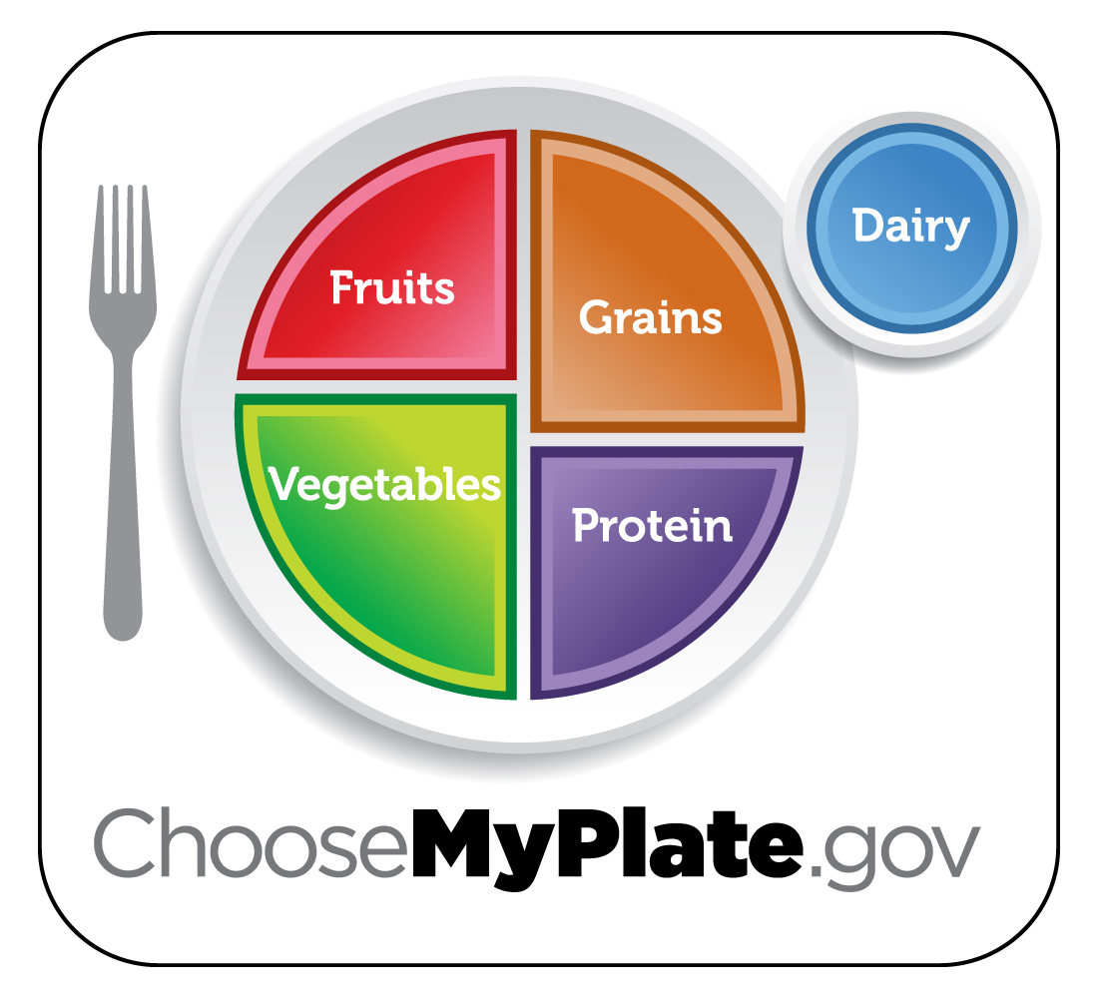
Unit 2: Every Bite Counts!
The lessons and activities in this unit center around the MyPlate recommendations from the USDA.
Each activity comes
with creative snack
ideas to serve during
class time. These align
with key teaching points
in the curriculum but are
optional.

Slide 18
Meal-Planning: Key Points
Look at the big picture.
It’s the eating pattern that matters, not just the choices you make on one particular day. What’s an eating pattern? The combination of all the foods and beverages a person eats and drinks over time.
Strive for Five.
Eat a mix of foods across all food groups. Choose foods and beverages from all 5 food groups — vegetables, fruits, grains, dairy and protein foods — not just 1 or 2 of them.

Slide 19
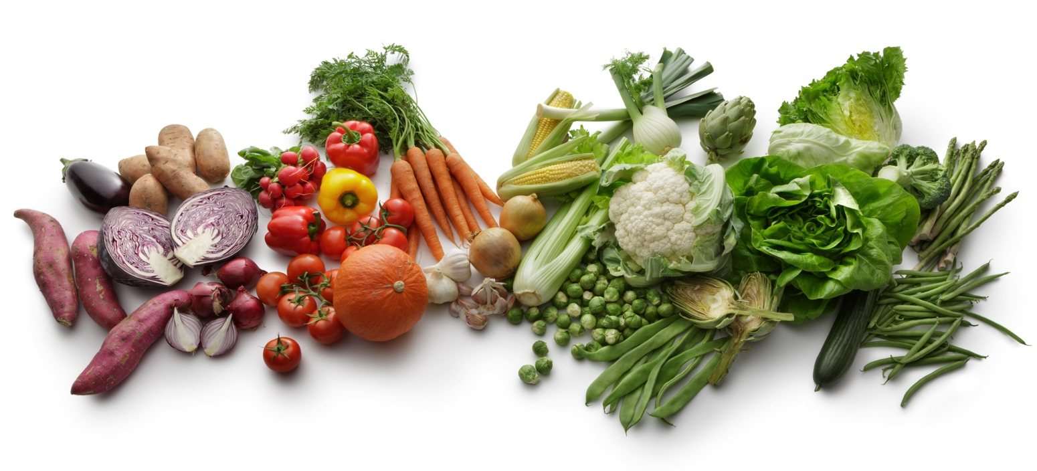
Meal-Planning: Key Points
Mix it up!
Eat a mix of foods within each food group. For example, each week try eating several types of vegetables, including dark green, red and orange, starchy ones, legumes and others. Switch up the protein foods you eat, too — for example, consider fish, black beans, and peanut butter, not just lean meats and poultry.

Slide 20
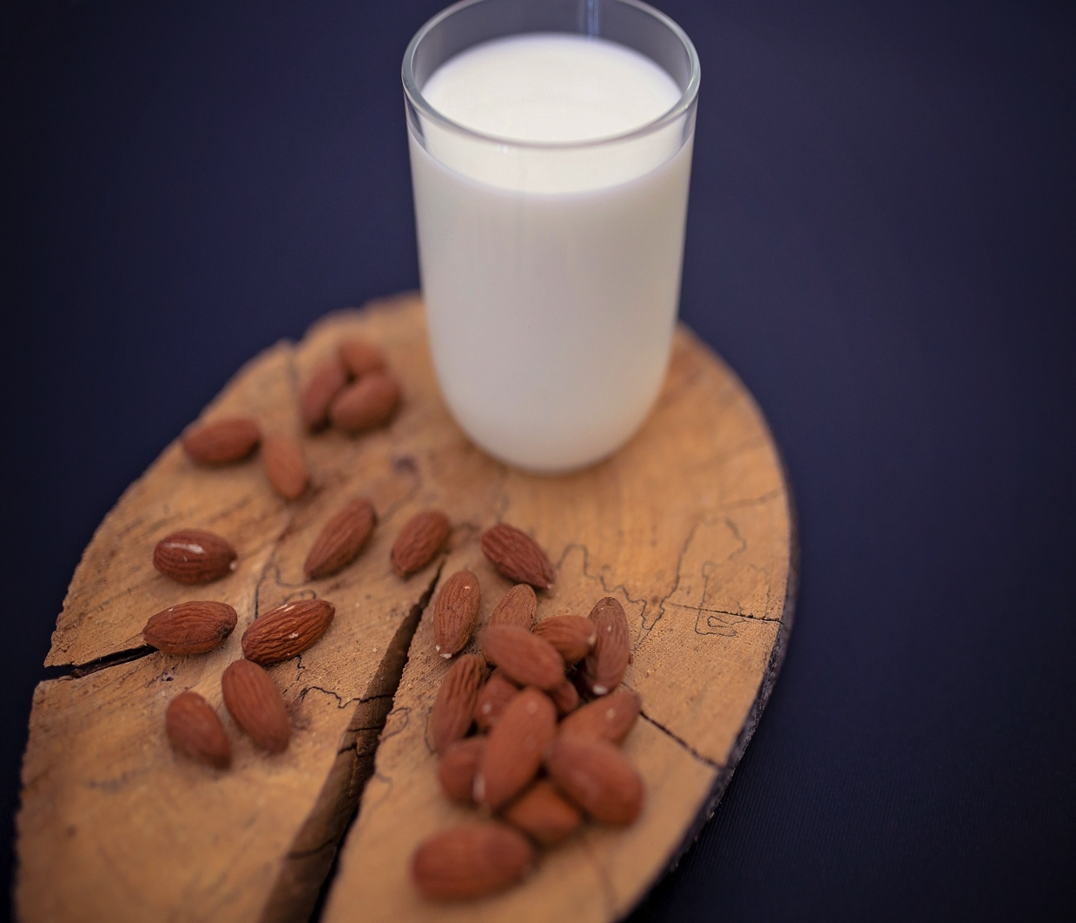
Meal-Planning: Key Points
Aim for balance and moderation.
Try to eat and drink the right
amounts for you. How many
calories you need to eat
depends on your age, gender,
height, weight and how active
you are.
Use the MyPlate Plan at
www.choosemyplate.gov/GetMyPlan
to find a plan that is right for you.

Slide 21
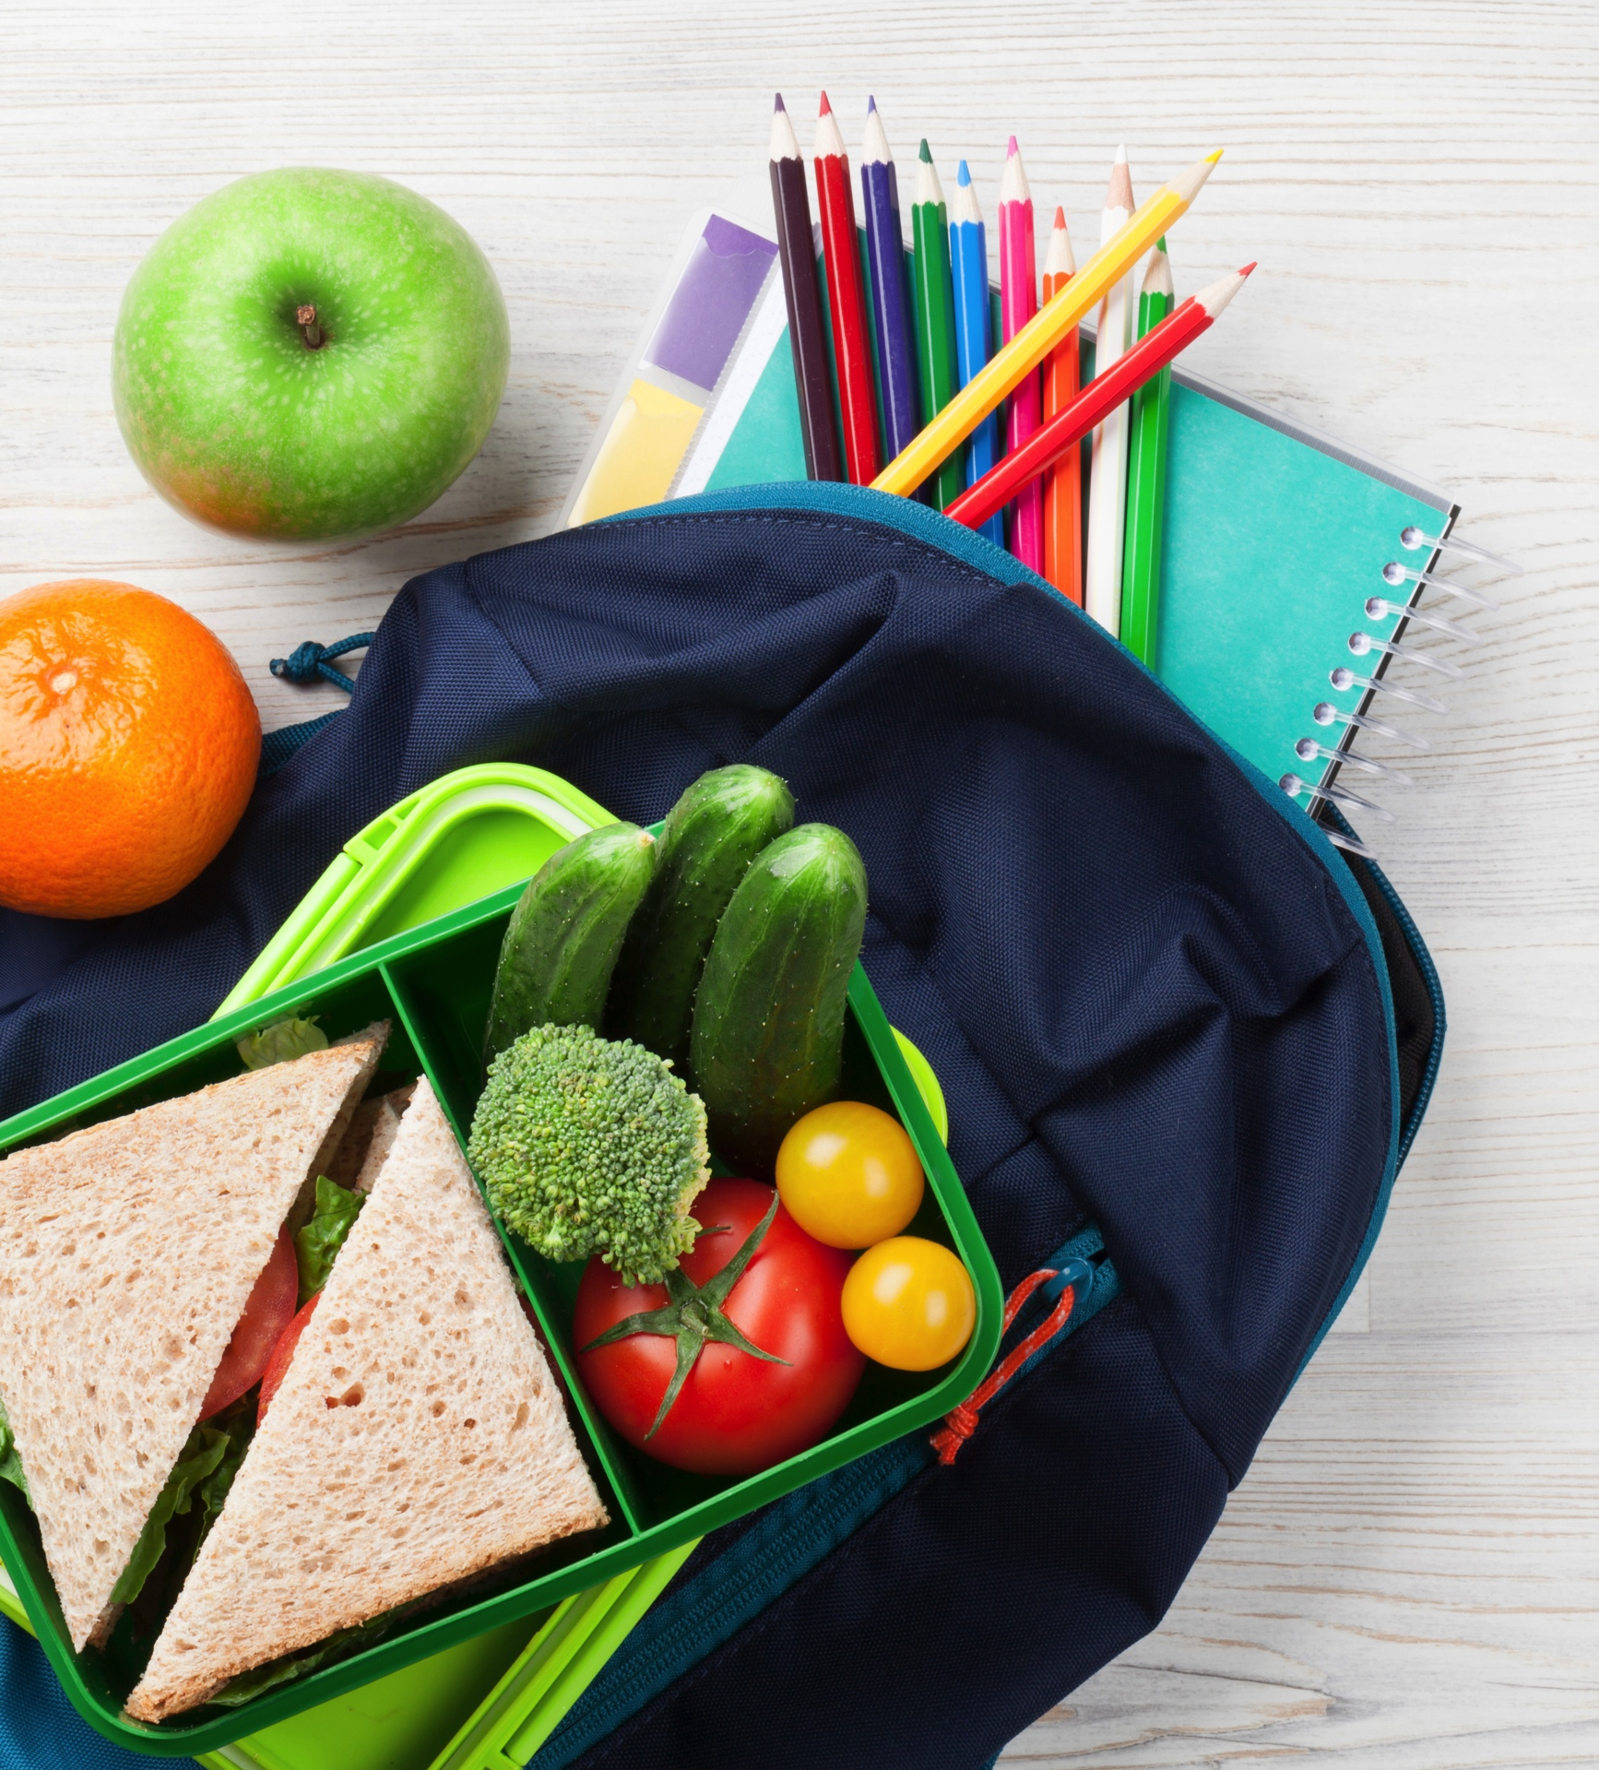
Unit 2: Every Bite Counts!
Time for a snack break?
See the activity choices in
the download.

Slide 22
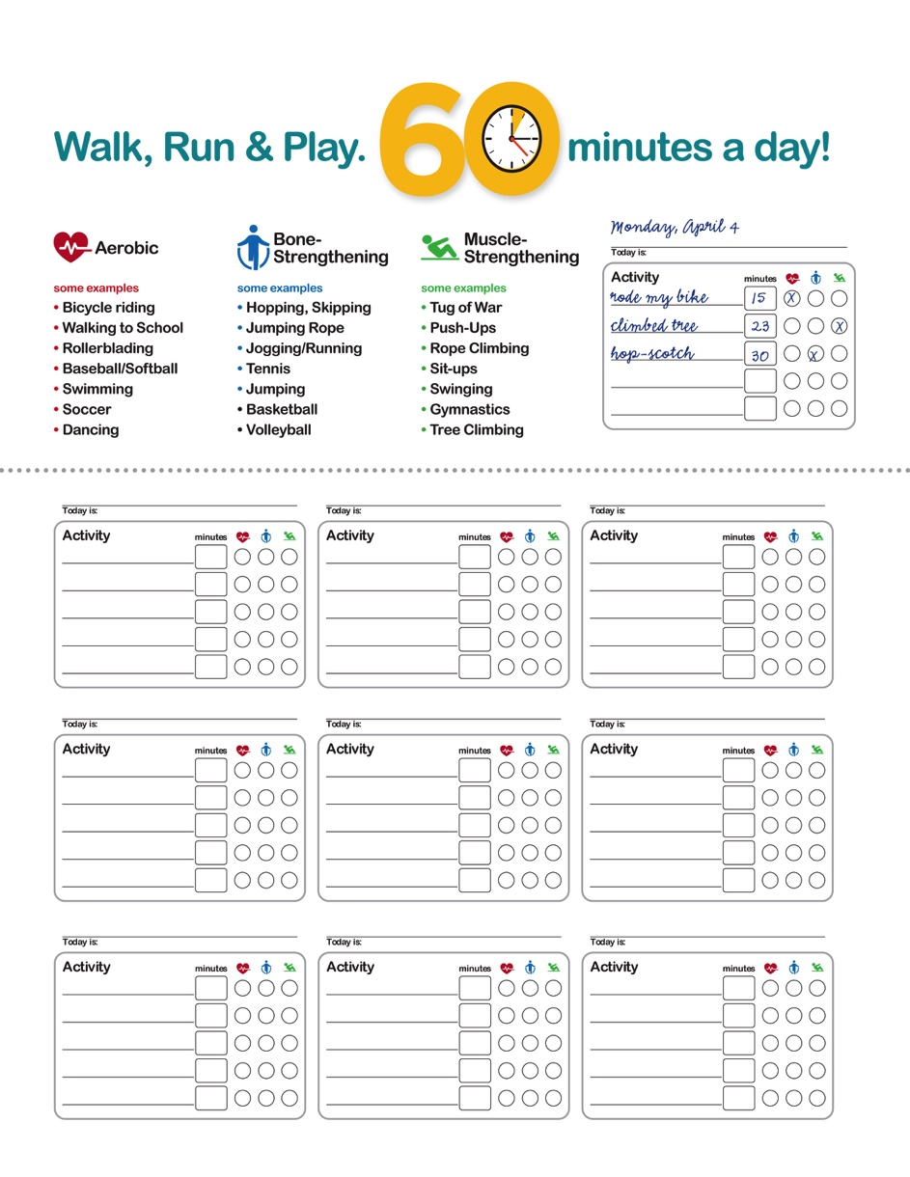
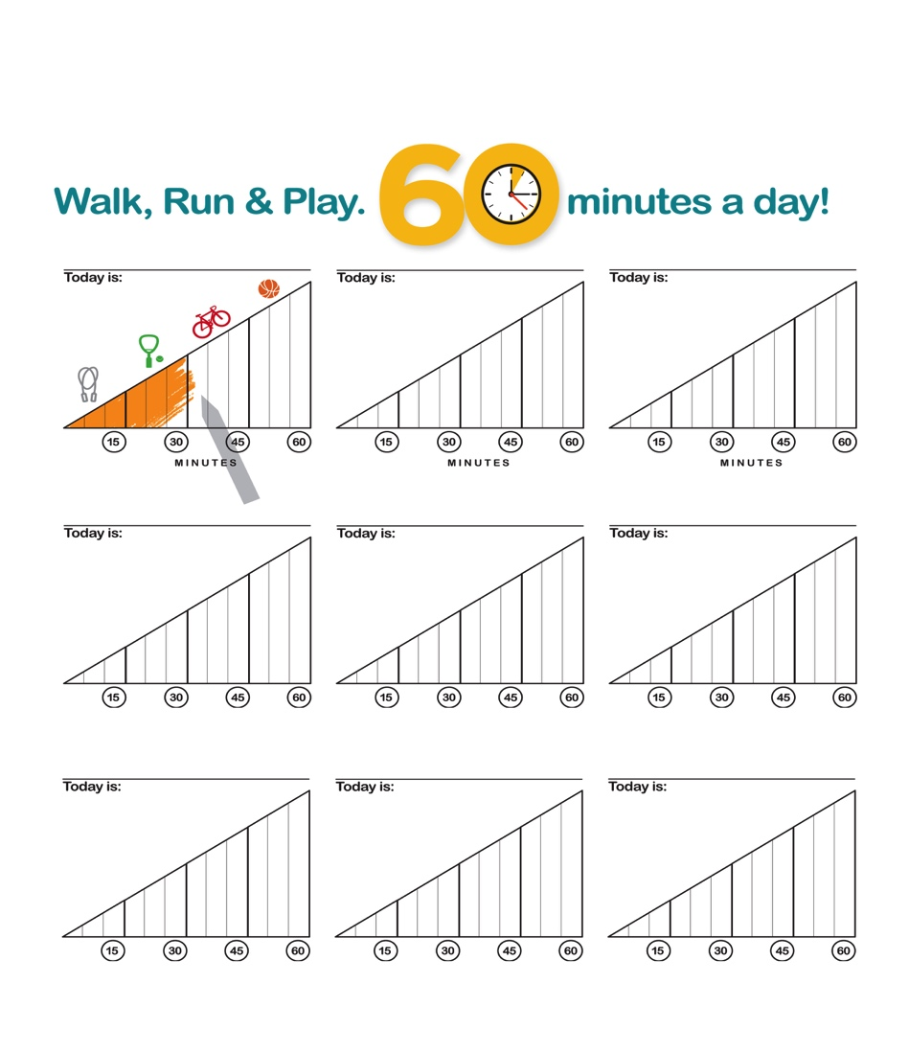
Unit 3: Every Move Counts
All students should have a common goal: engaging in 60 minutes of physical activity a day. Both the CDC and the American Heart Association recommend this be moderate-to-vigorous activity.

Slide 23
Unit 3: Every Move Counts
Lessons like “Strive for 60” come with downloadable Physical Activity Charts for setting and tracking goals. These can also be used with all the other physical activity lessons in this unit.

Slide 24
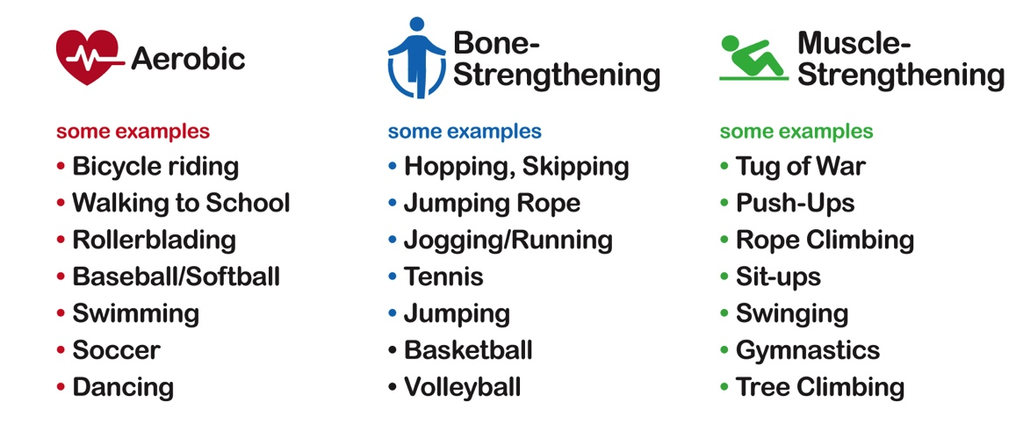
Unit 3: Every Move Counts
Big Goals, Mini Goals
Students learn the three basic types of physical activity — aerobic, bone-strengthening and muscle-strengthening — and then break down the aerobic category into light, moderate and vigorous to learn the distinction between them.

Slide 25

Unit 3: Every Move Counts
Brain Exercises
Get both hemispheres in shape!
Double Cross
Grab your left ear with your right hand, keeping your right arm tucked close to your body. Now take your left hand and touch your nose. Uncross
your arms and do the opposite, grabbing your right ear with your left hand and touch your nose with your right hand. Switch back and forth as fast as you can!

Slide 26
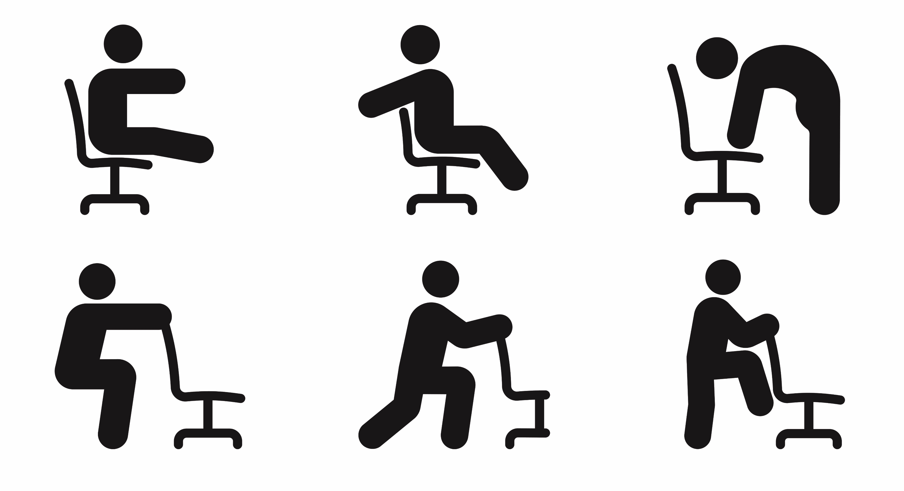
Unit 3: Every Move Counts
Desk Exercises
These include one-minute energizers, yoga poses and brain exercises.
Let’s give some of them a try!

Slide 27
Healthy Bodies, Healthy Minds
Cross Crawl
Exercise the information flow between the right and left hemispheres of the brain with this simple activity. While slowly marching in place, touch each knee as you raise it with your opposite hand. Do this for one minute. As an extra challenge, continue for another minute, this time with your eyes closed.
Focus Pocus
Standing straight, cross your right ankle over your left ankle. Now cross your right wrist over your left wrist and align your fingers, keeping your right wrist on top. Extend your elbows outward and turn your fingers in and rest them in the center of your chest. Stay in this position, breathe deeply and focus for one minute.

Slide 28
Healthy Bodies, Healthy Minds
Relax and Unwind
Shoulder Shrug
Take a slow, deep breath in while shrugging your shoulders, lifting them high up to your ears. Hold 3 seconds and then release. Repeat three times.
Yes and No
Shake your head slowly from side to side and then up and down. Pretend you’re saying No, No, No 6 times and then Yes, Yes, Yes 6 times. Repeat.

Slide 29
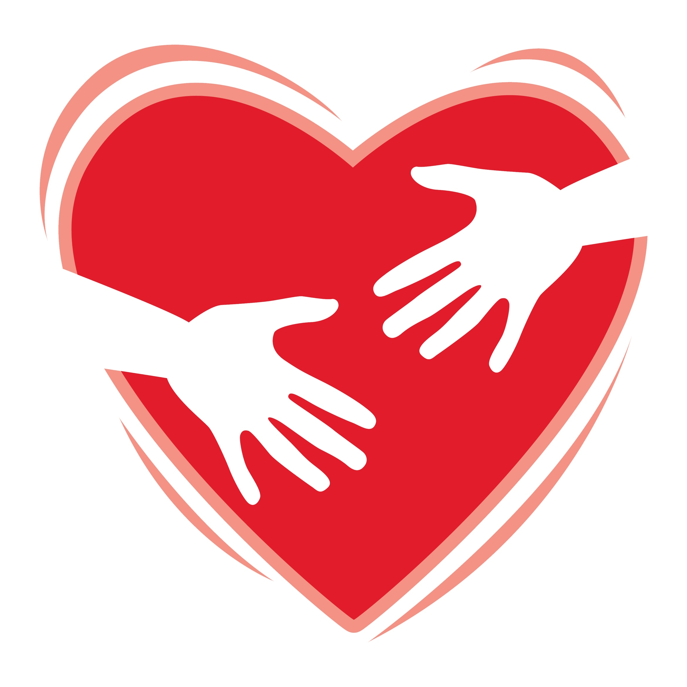
Healthy Bodies, Healthy Minds
Bear Hug
Give yourself a great big hug and release the tension in your back while you’re at it. Put your right hand on your left shoulder and your left hand on your right shoulder.
Now breathe in and out deeply, gently squeezing the area between your shoulder blades.

Slide 30
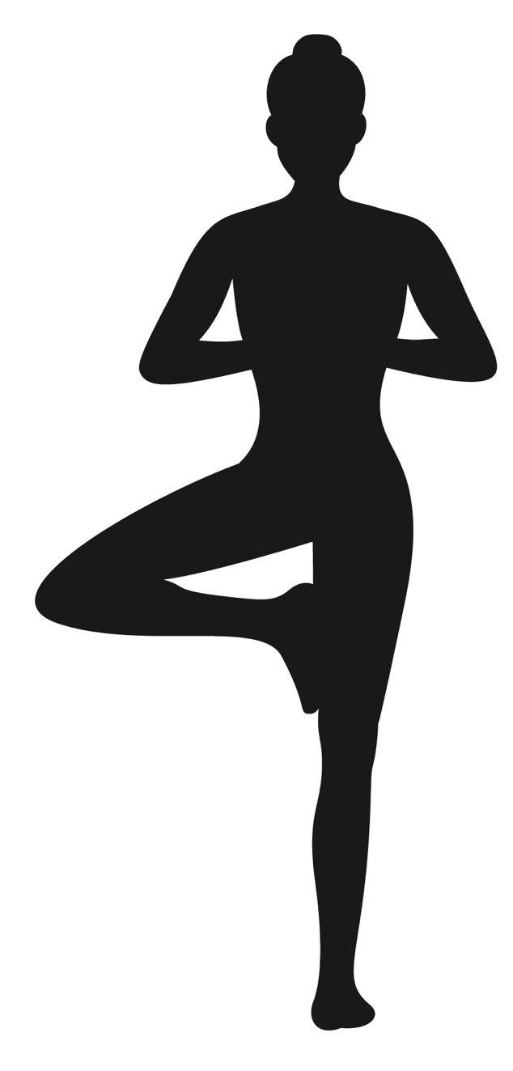
Healthy Bodies, Healthy Minds
“Desk Zen” Yoga Poses
Stork Stand
Stand next to your desk. Place your hands on your hips, then stand on one leg and position your other foot against the inside knee of your standing leg. Take a deep breath and see how long you can balance. Now switch legs. After a few successful stands, try it with eyes closed!

Slide 31
Healthy Bodies, Healthy Minds
Belly Breathing
Take a deep breath. Now take another deep breath but stay as still as possible and do not move your shoulders. Breathe very slowly through your nose and put your hands on your stomach. Your stomach should be the only thing you feel moving. Pay close attention while you breathe and feel your hands going up and down with each breath.
Balanced Breathing
Now do Belly Breathing but count to develop an even rhythm. Breathe in for 3 seconds, then breathe out for 3. Then repeat for 4 seconds, then repeat for 5 seconds. How does it make you feel?

Slide 32
Rest & Reflect
How do you feel?
Can you think of students who might benefit from breathing exercises or stress-buster activities?
Can you think of ways to integrate more physical activity into your school day?
How about nutrition-based activities and healthy snacks?
Which of today’s activities did you like best?

Slide 33

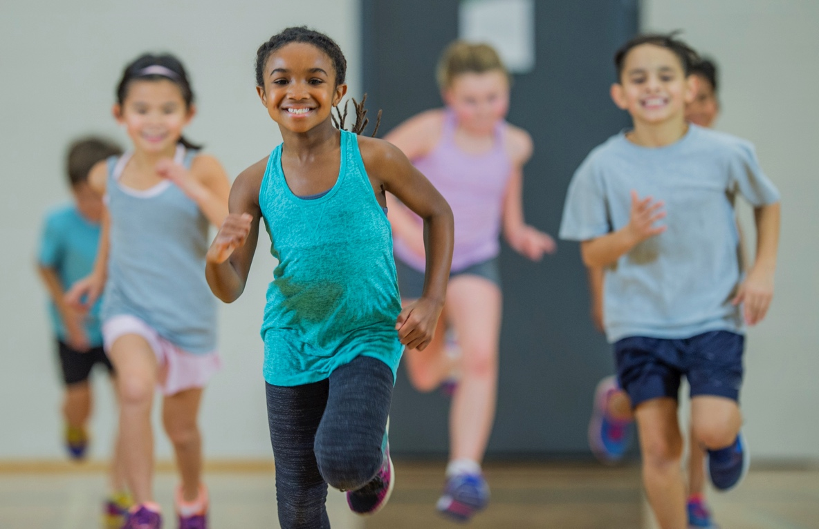
Physical Wellness
What ideas will you try to incorporate in your classroom?

Slide 34

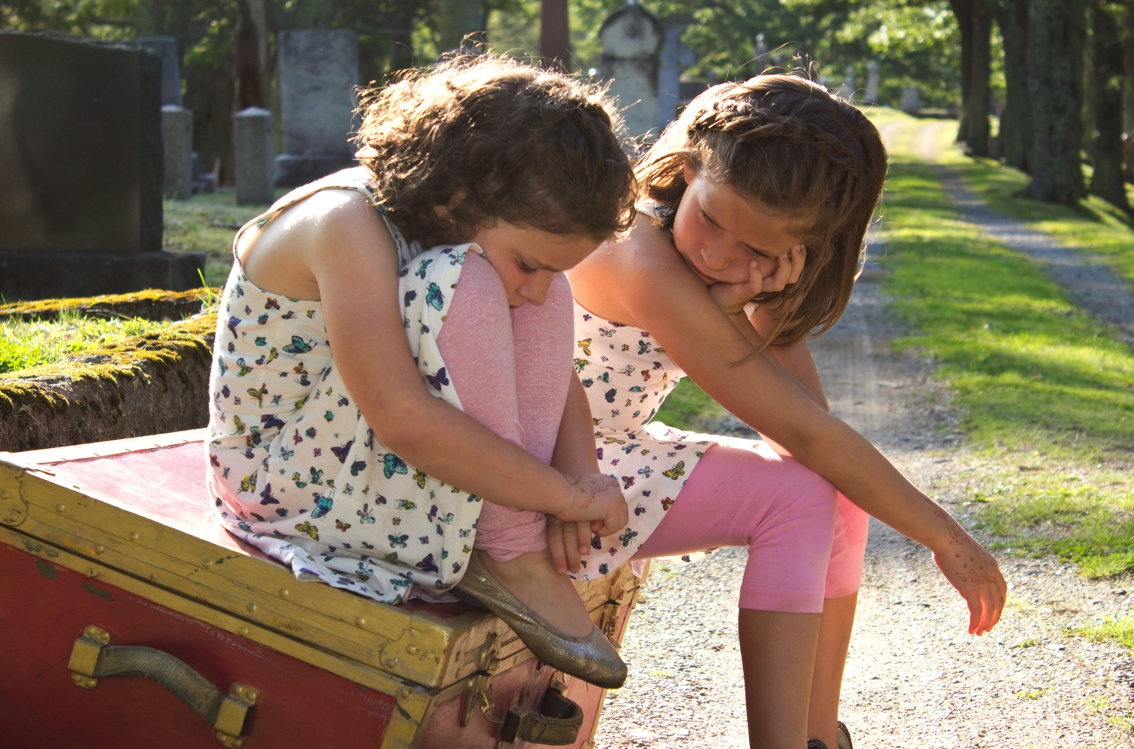
Social Wellness
What ideas will you try to incorporate in your classroom?

Slide 35
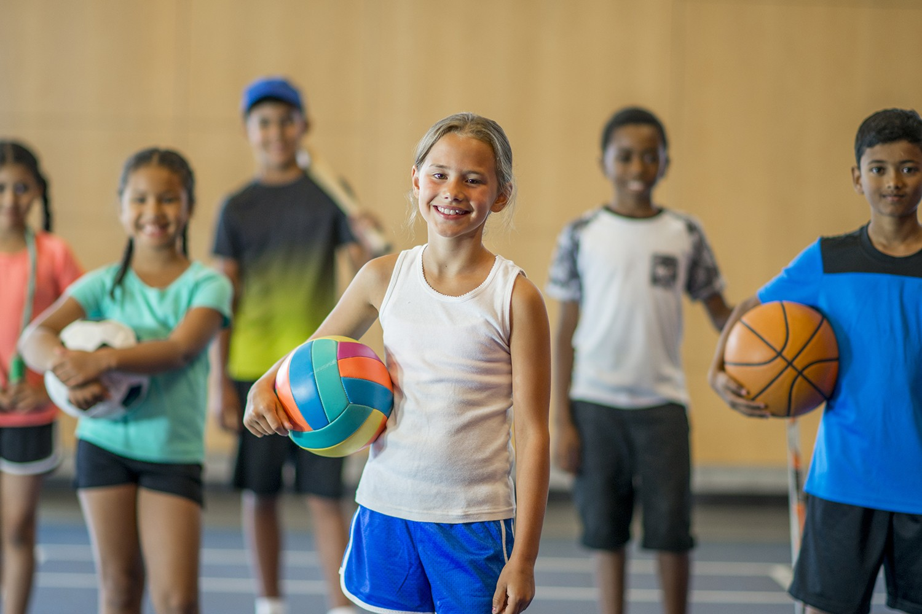
Mental & Emotional Wellness
What ideas will you try to incorporate in your classroom?

Slide 36
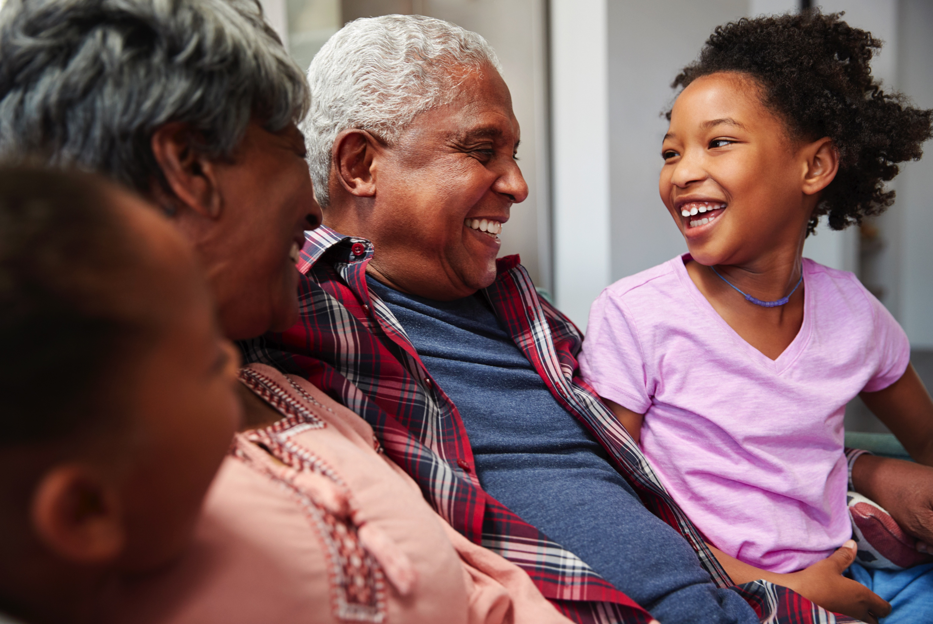
Family Connections
How can we include families in the conversation?
How can we promote wellness at home?

Slide 37
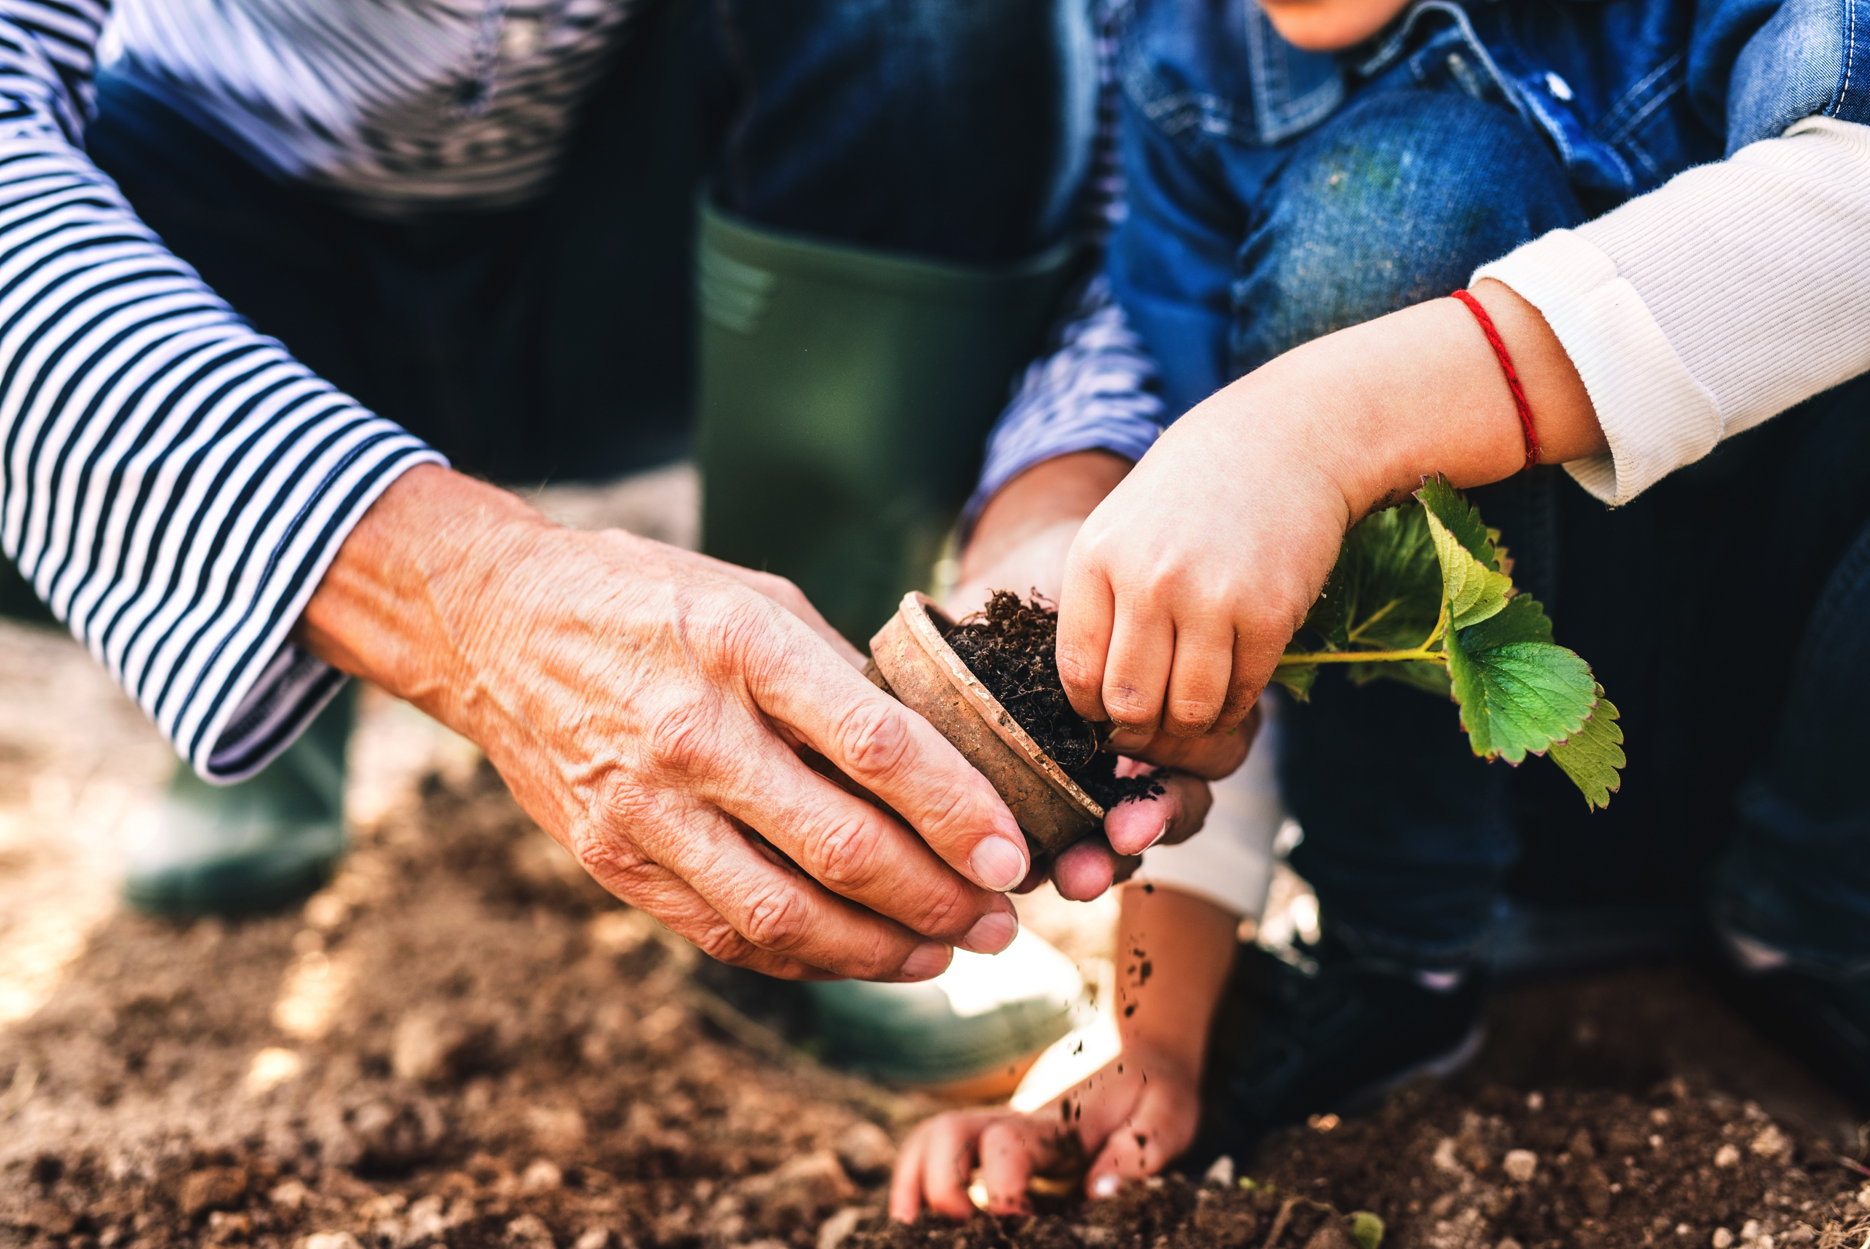
Community Connections
How can we promote wellness throughout the community?
How can we build stronger ties between the
community and our schools?

